Slide 1
CIRCUIT AND SYSTEMS
COURSE CODE: ETEE-207
By
Mr. LALIT AGARWAL
ASSISTANT PROFESSOR
EEE, MAIT

Slide 2
LECTURE- 6,7,8 &9

Slide 3
CIRCUIT ANALYSIS
BY
CLASSICAL METHOD

Slide 4
What is transient?
What are the transient and steady states?
What is Transient response?
What is steady state response?
What do you mean by opening and closing of the switch?

Slide 5
Whenever a circuit is switched from one condition to another by a change in the applied source or change in the circuit elements, there is a transition period during which the branch currents and element voltages change from their former values to new ones. This period is called as the “Transient” .
And this state is called as the transient state(t=0).
Transient state is also called as the initial state.
After the transients have died out or passed, the circuit is said to be in the steady state(t>0).
Steady state is also called as the final state.

Slide 6
TRANSIENT RESPONSE:
The values of voltage and current during the transient period are known as the transient responses.
It is also defined as the part of the total time response that goes to zero as time becomes large.
It depends on the network elements alone and independent of the forcing function(source).
STEADY STATE RESPONSE:
The values of voltage and current after the transient has died out are known as the steady state responses.
It is also defined as the part of the total time response which remains after the transient has passed.
It depends on both the network elements and the forcing function(source).

Slide 7
We can say that;
Total time response = Transient response
+
steady state response

Slide 8
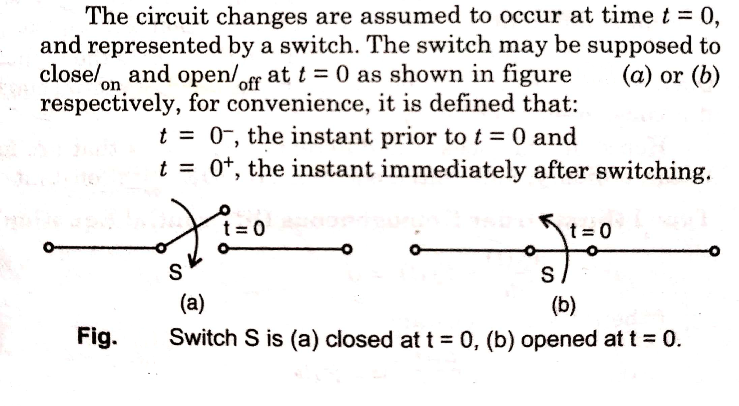
Note: Switching on or off an element or source in a circuit at t=0 will not disturb the storage element so that,
i_{L}(0⁻) = i_{L}(0⁺) and;
v_{c}(0⁻) = v_{c}(0⁺)

Slide 9
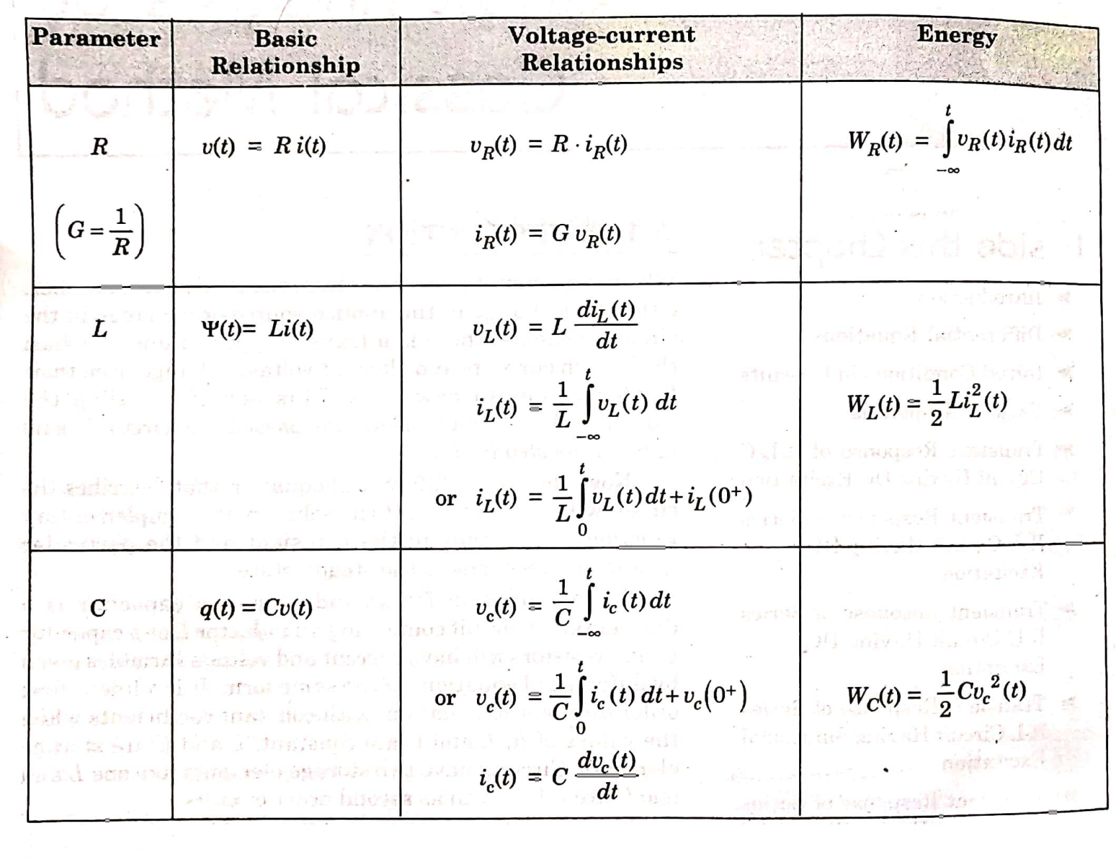
VOLTAGE –CURRENT RELATIONSHIP OF R, L, C

Slide 10
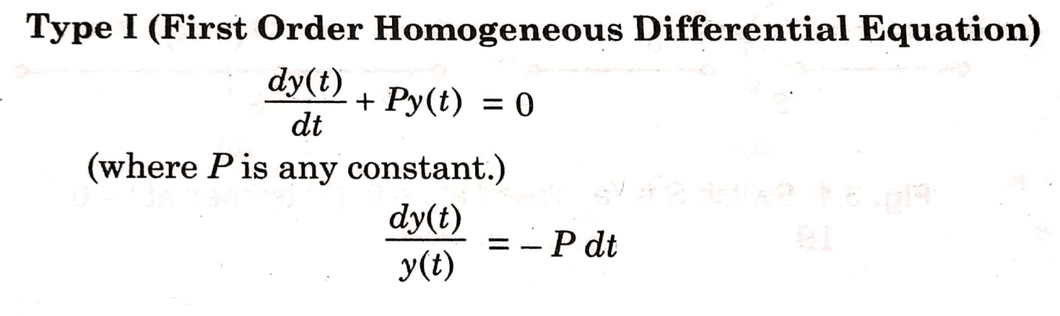
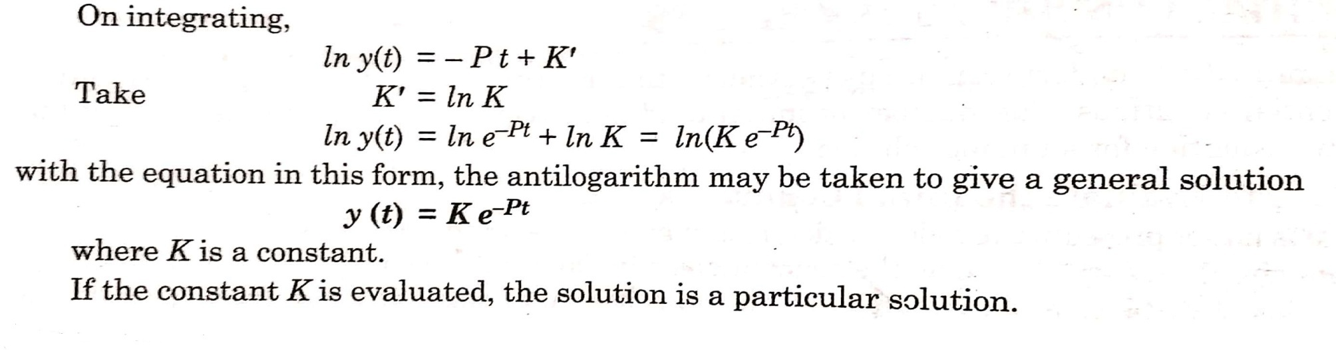
DIFFERENTIAL EQUATIONS
For the circuit analysis calculation in the classical method, it is necessary to be familiar with the mathematical concept of differential equations and the solution techniques.

Slide 11
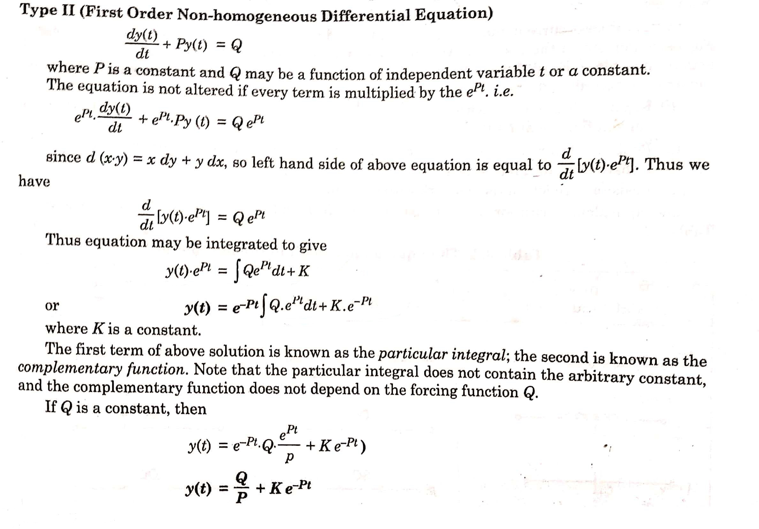

Slide 12
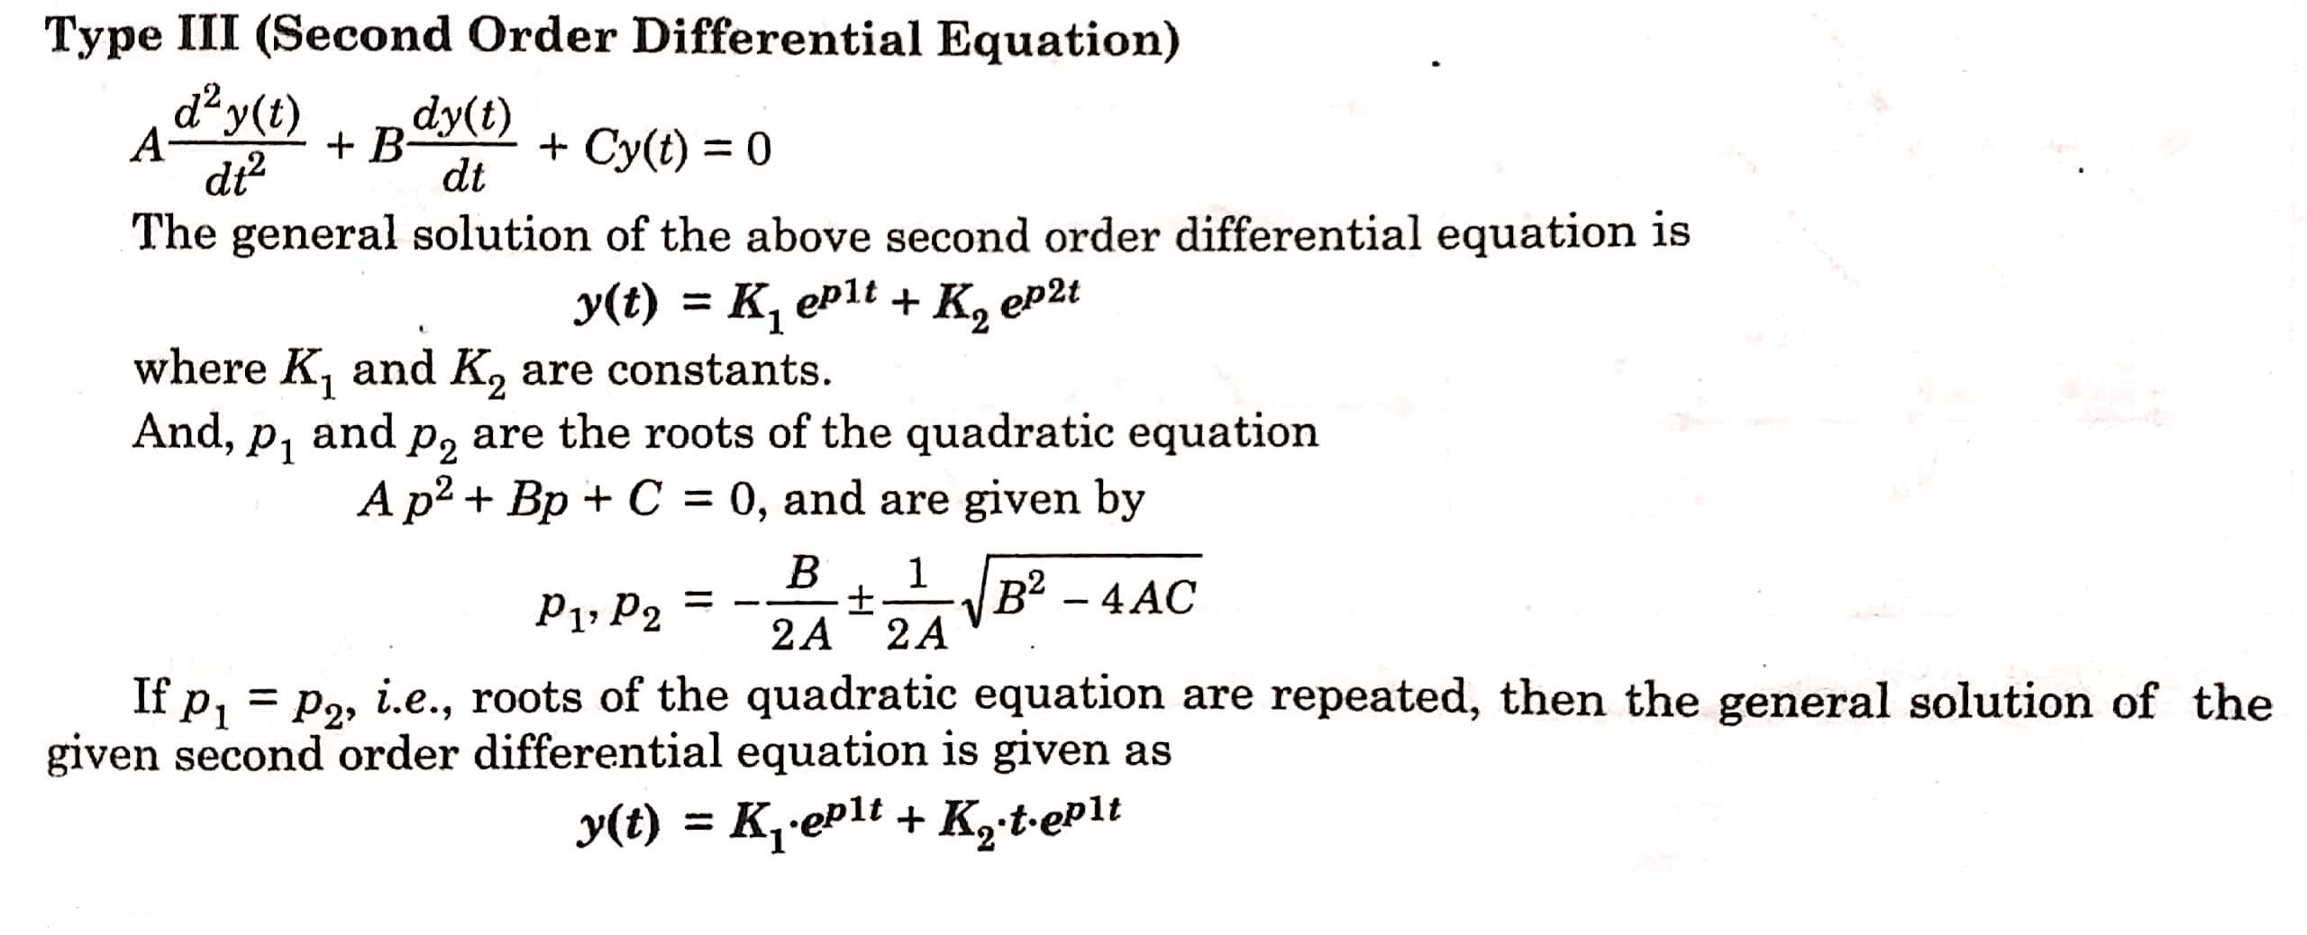

Slide 13
INITIAL CONDITIONS
Initial conditions are used to calculate the value of arbitrary constants in the general solution of differential equations.
The number of initial conditions required = Order of the differential equation for a unique solution.
PROCEDURE TO EVALUATE INITIAL CONDITIONS:
Replace all the inductors with open circuits or with the current generators having the value of current flowing at
t = 0⁺
Replace all the capacitors with short circuits or with voltage sources having the value V₀ = q₀/C if there is an initial charge, q₀.
Resistors are left in the network without change.

Slide 14
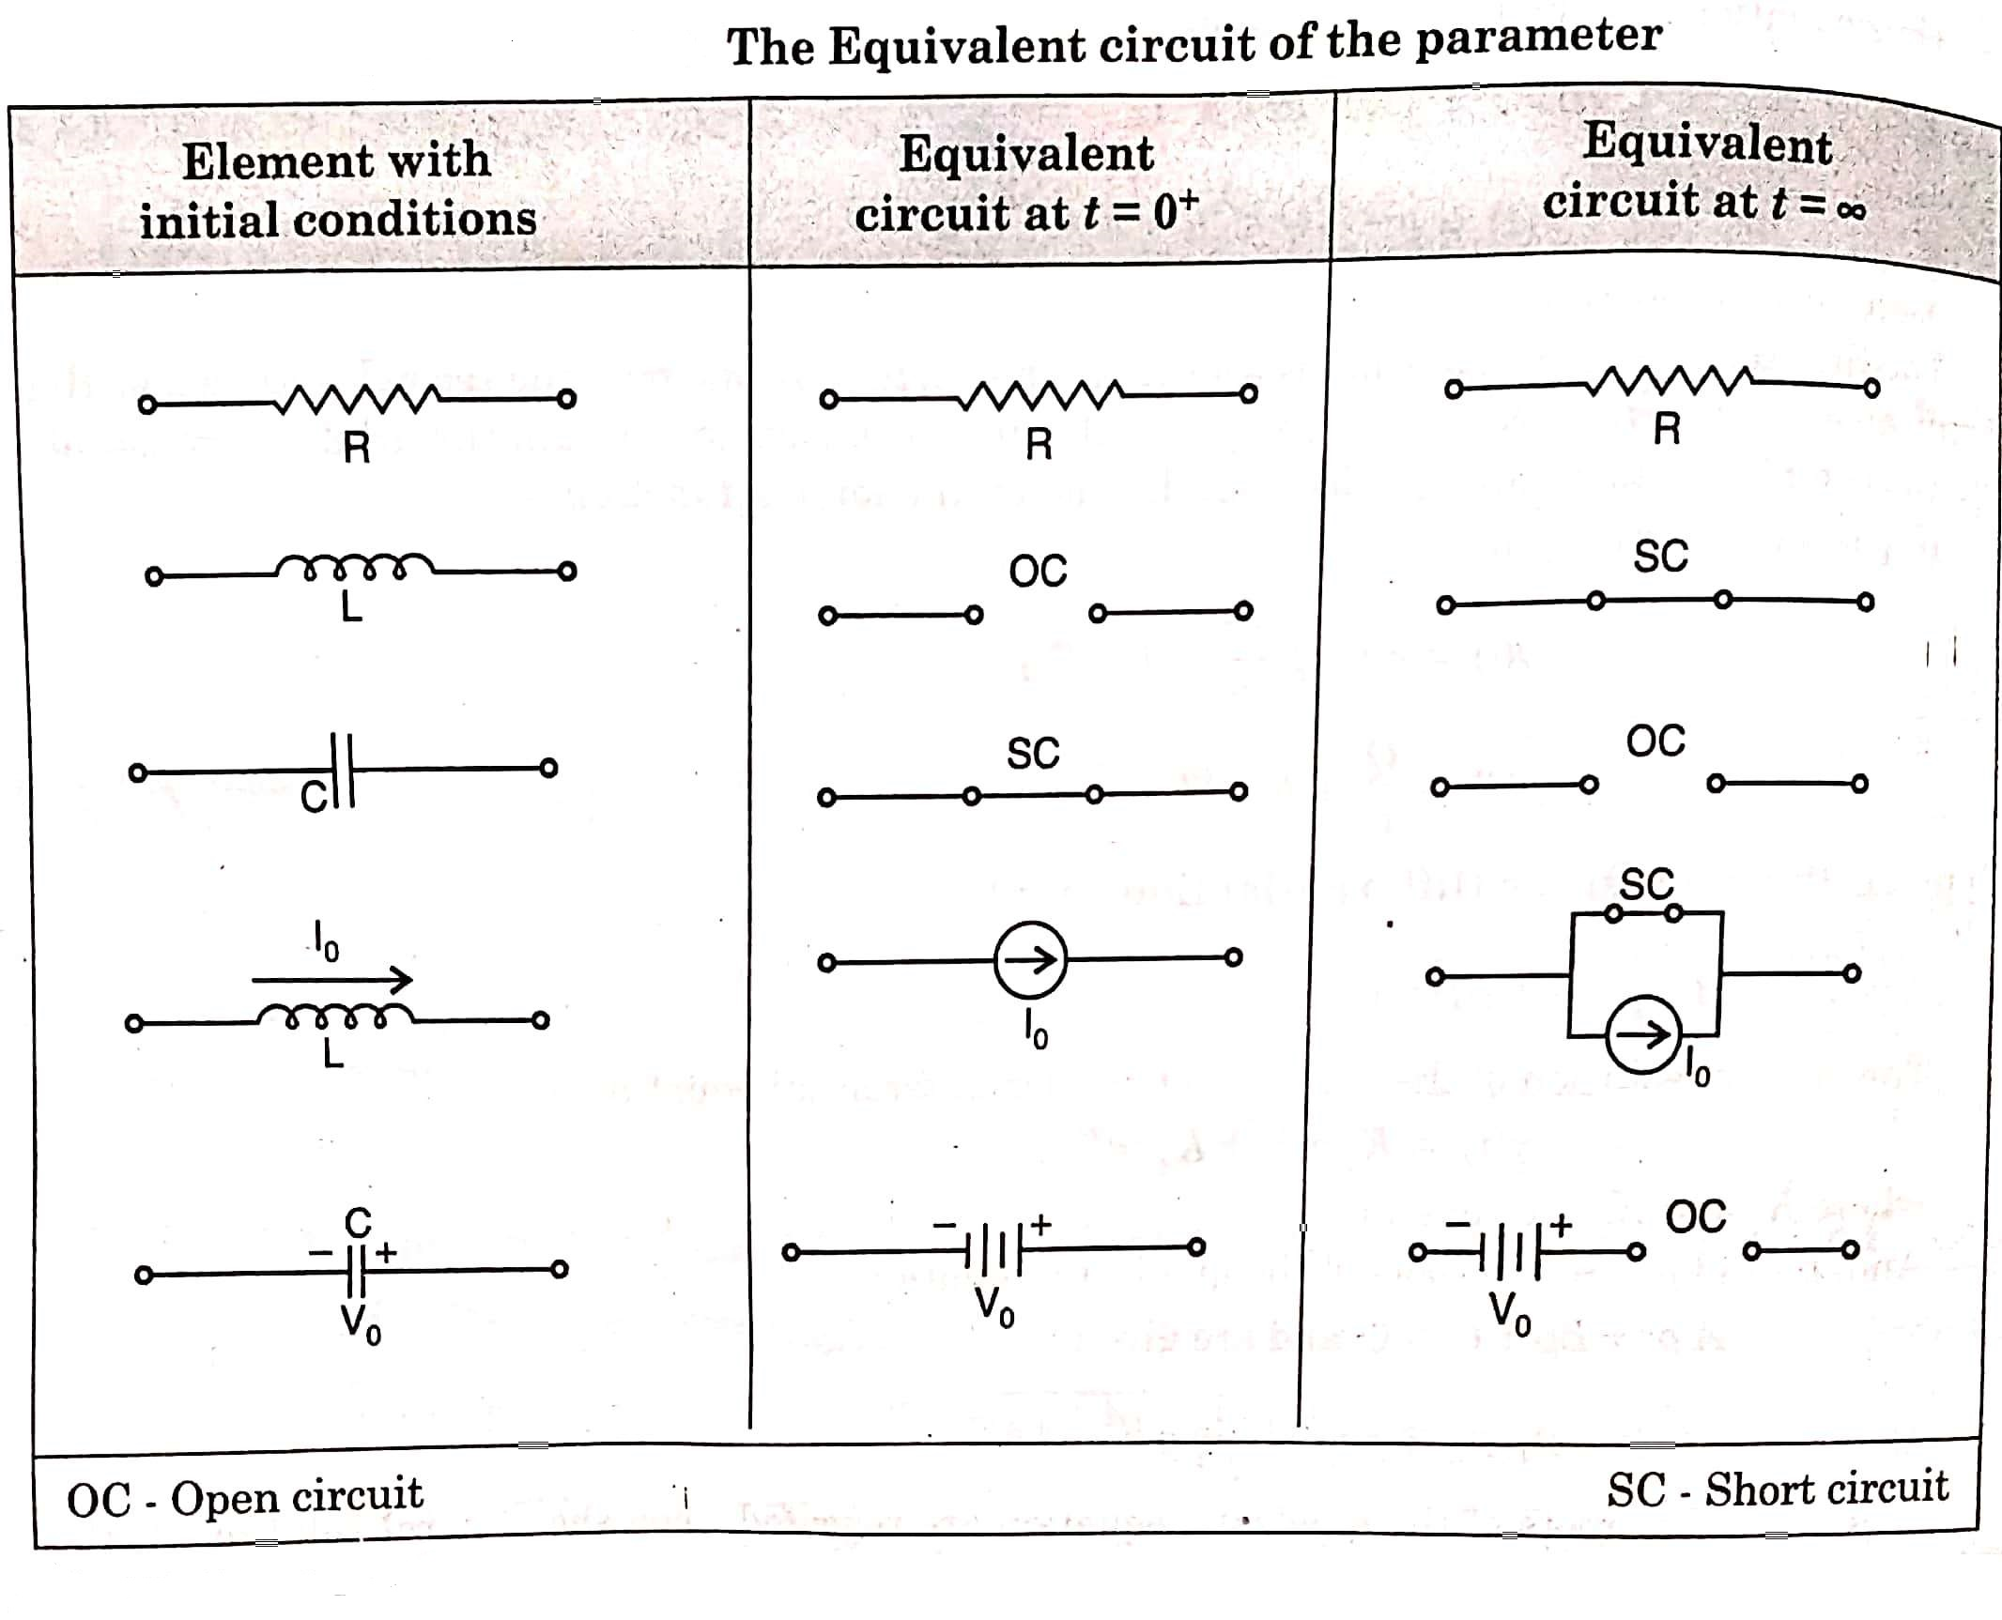

Slide 15
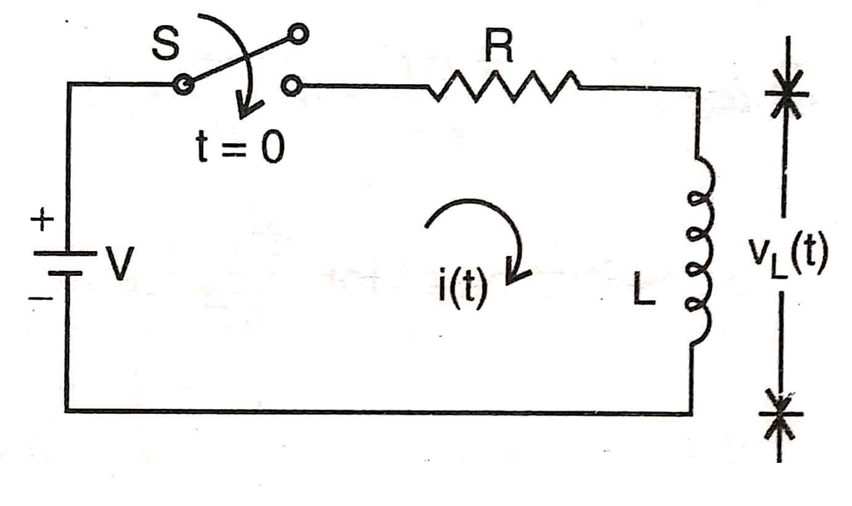
TRANSIENT RESPONSE OF R-L CIRCUIT HAVING DC EXCITATION
Ex 1) Consider a series R-L circuit shown in figure below. The switch is closed at time t = 0. Find the current i(t) and voltage across the resistor and inductor.

Slide 16
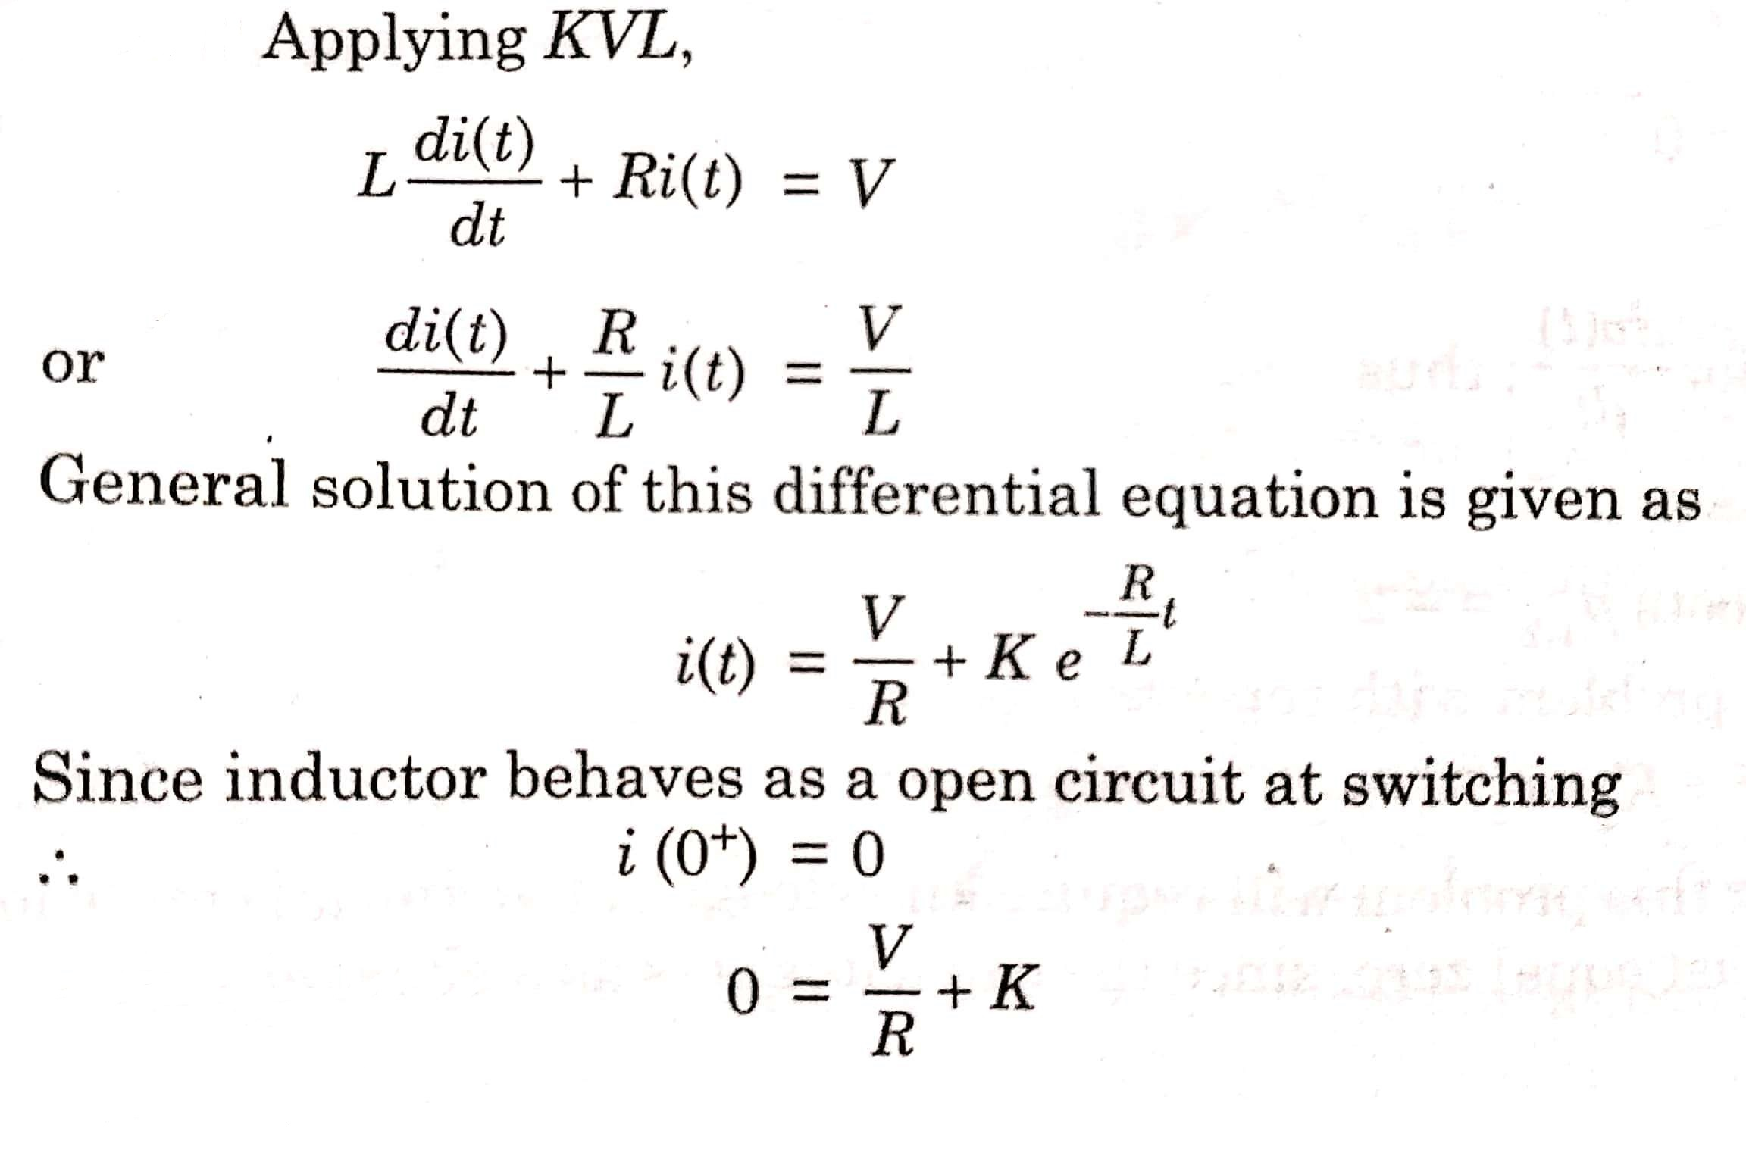
SOLUTION(1)

Slide 17
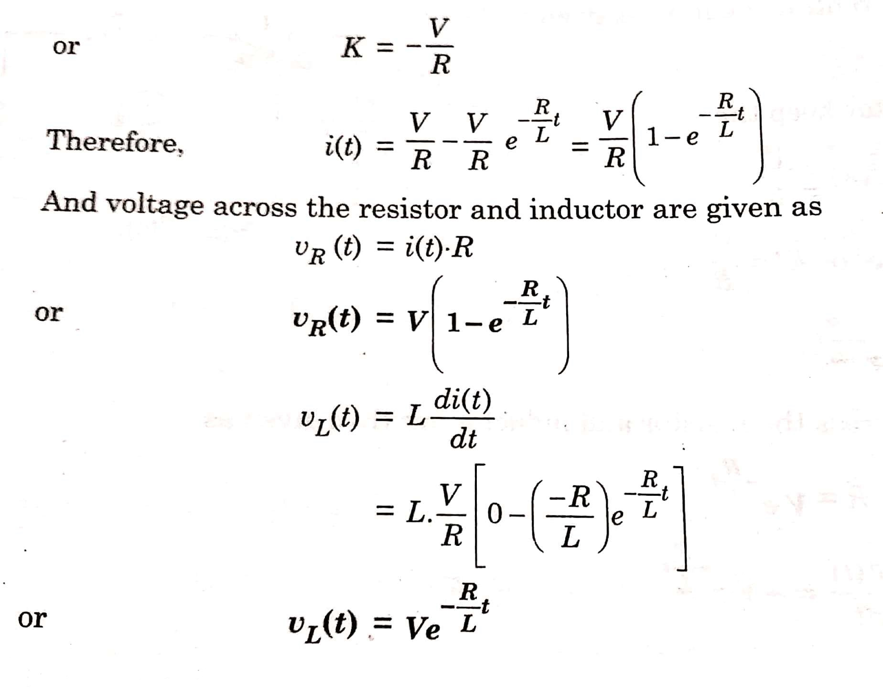

Slide 18
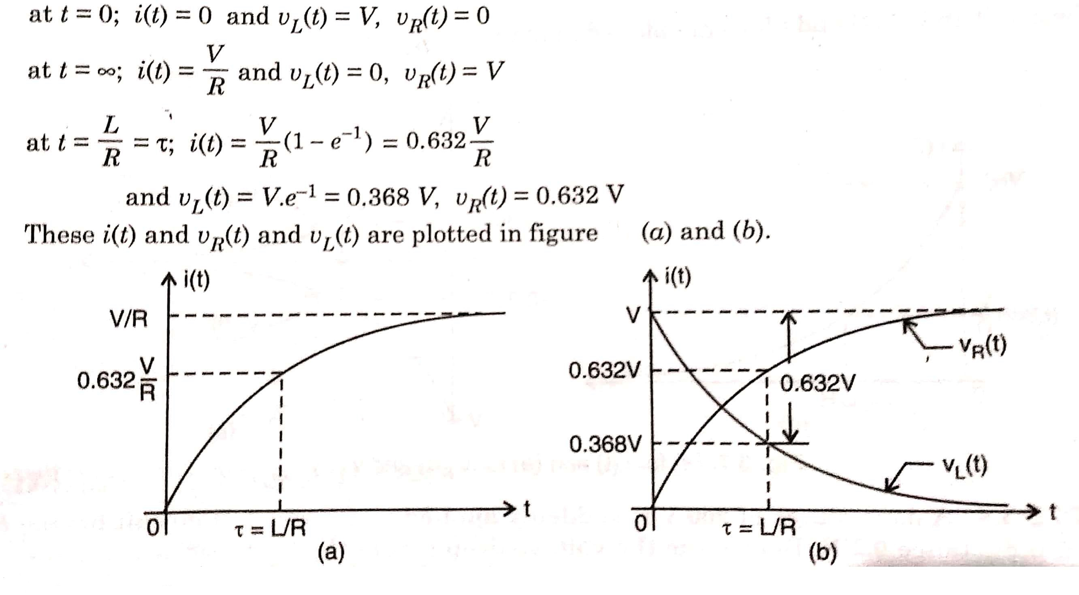

Slide 19
Ex 2) A d.c. voltage of 200 V is suddenly applied to a series R-L circuit having R = 20 Ω and inductance 0.2 H. Determine the voltage drop across the inductor at the instant of switching on and 0.02 sec. later.

Slide 20
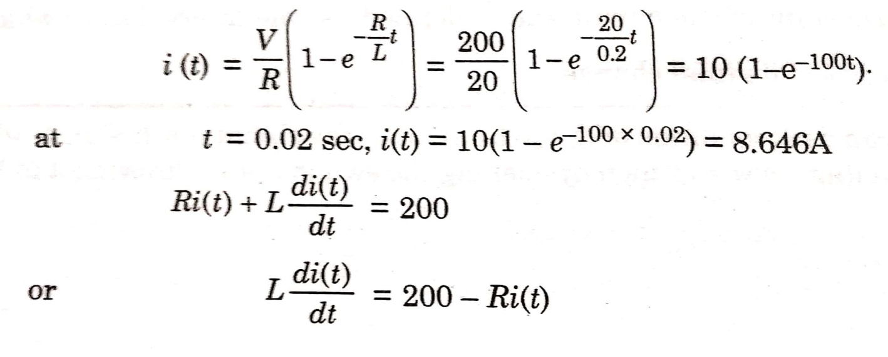
SOL (2)
Initially the inductor behaves as an open circuit at t = 0+ ,
then i(0⁺) = 0
Therefore, at the instant of switching, the voltage drop across inductor is = 200 V
Now, after the instant of switching the current is given by,
The voltage across the inductor after 0.02 sec from switching is given as:
L di (0.02) / dt = 200 – 20 * 8.646 = 27 V

Slide 21
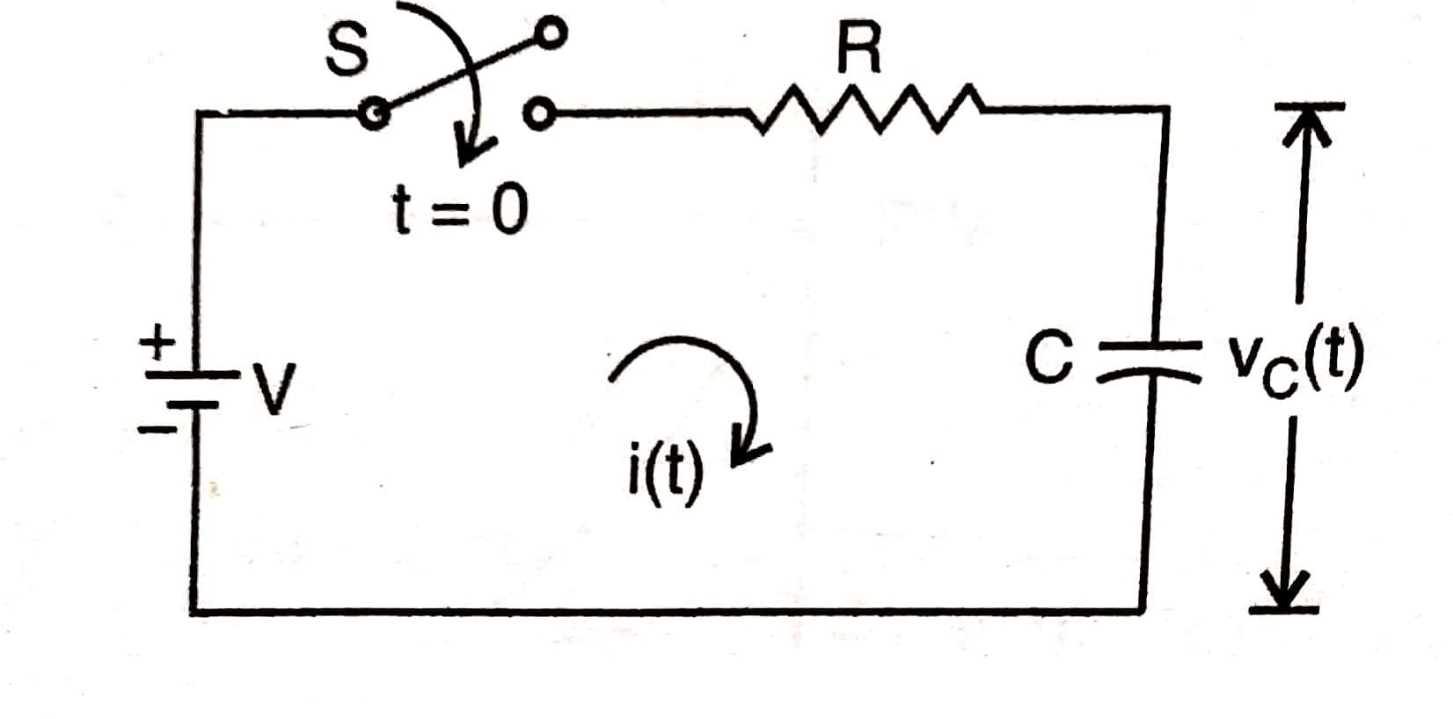
TRANSIENT RESPONSE OF SERIES R-C CIRCUIT HAVING DC EXCITATIION
Ex 3) Consider a series R-C circuit as shown in figure below. The switch ‘S’ is closed at time t = 0. Find the current i(t) and voltage across resistor and capacitor.

Slide 22
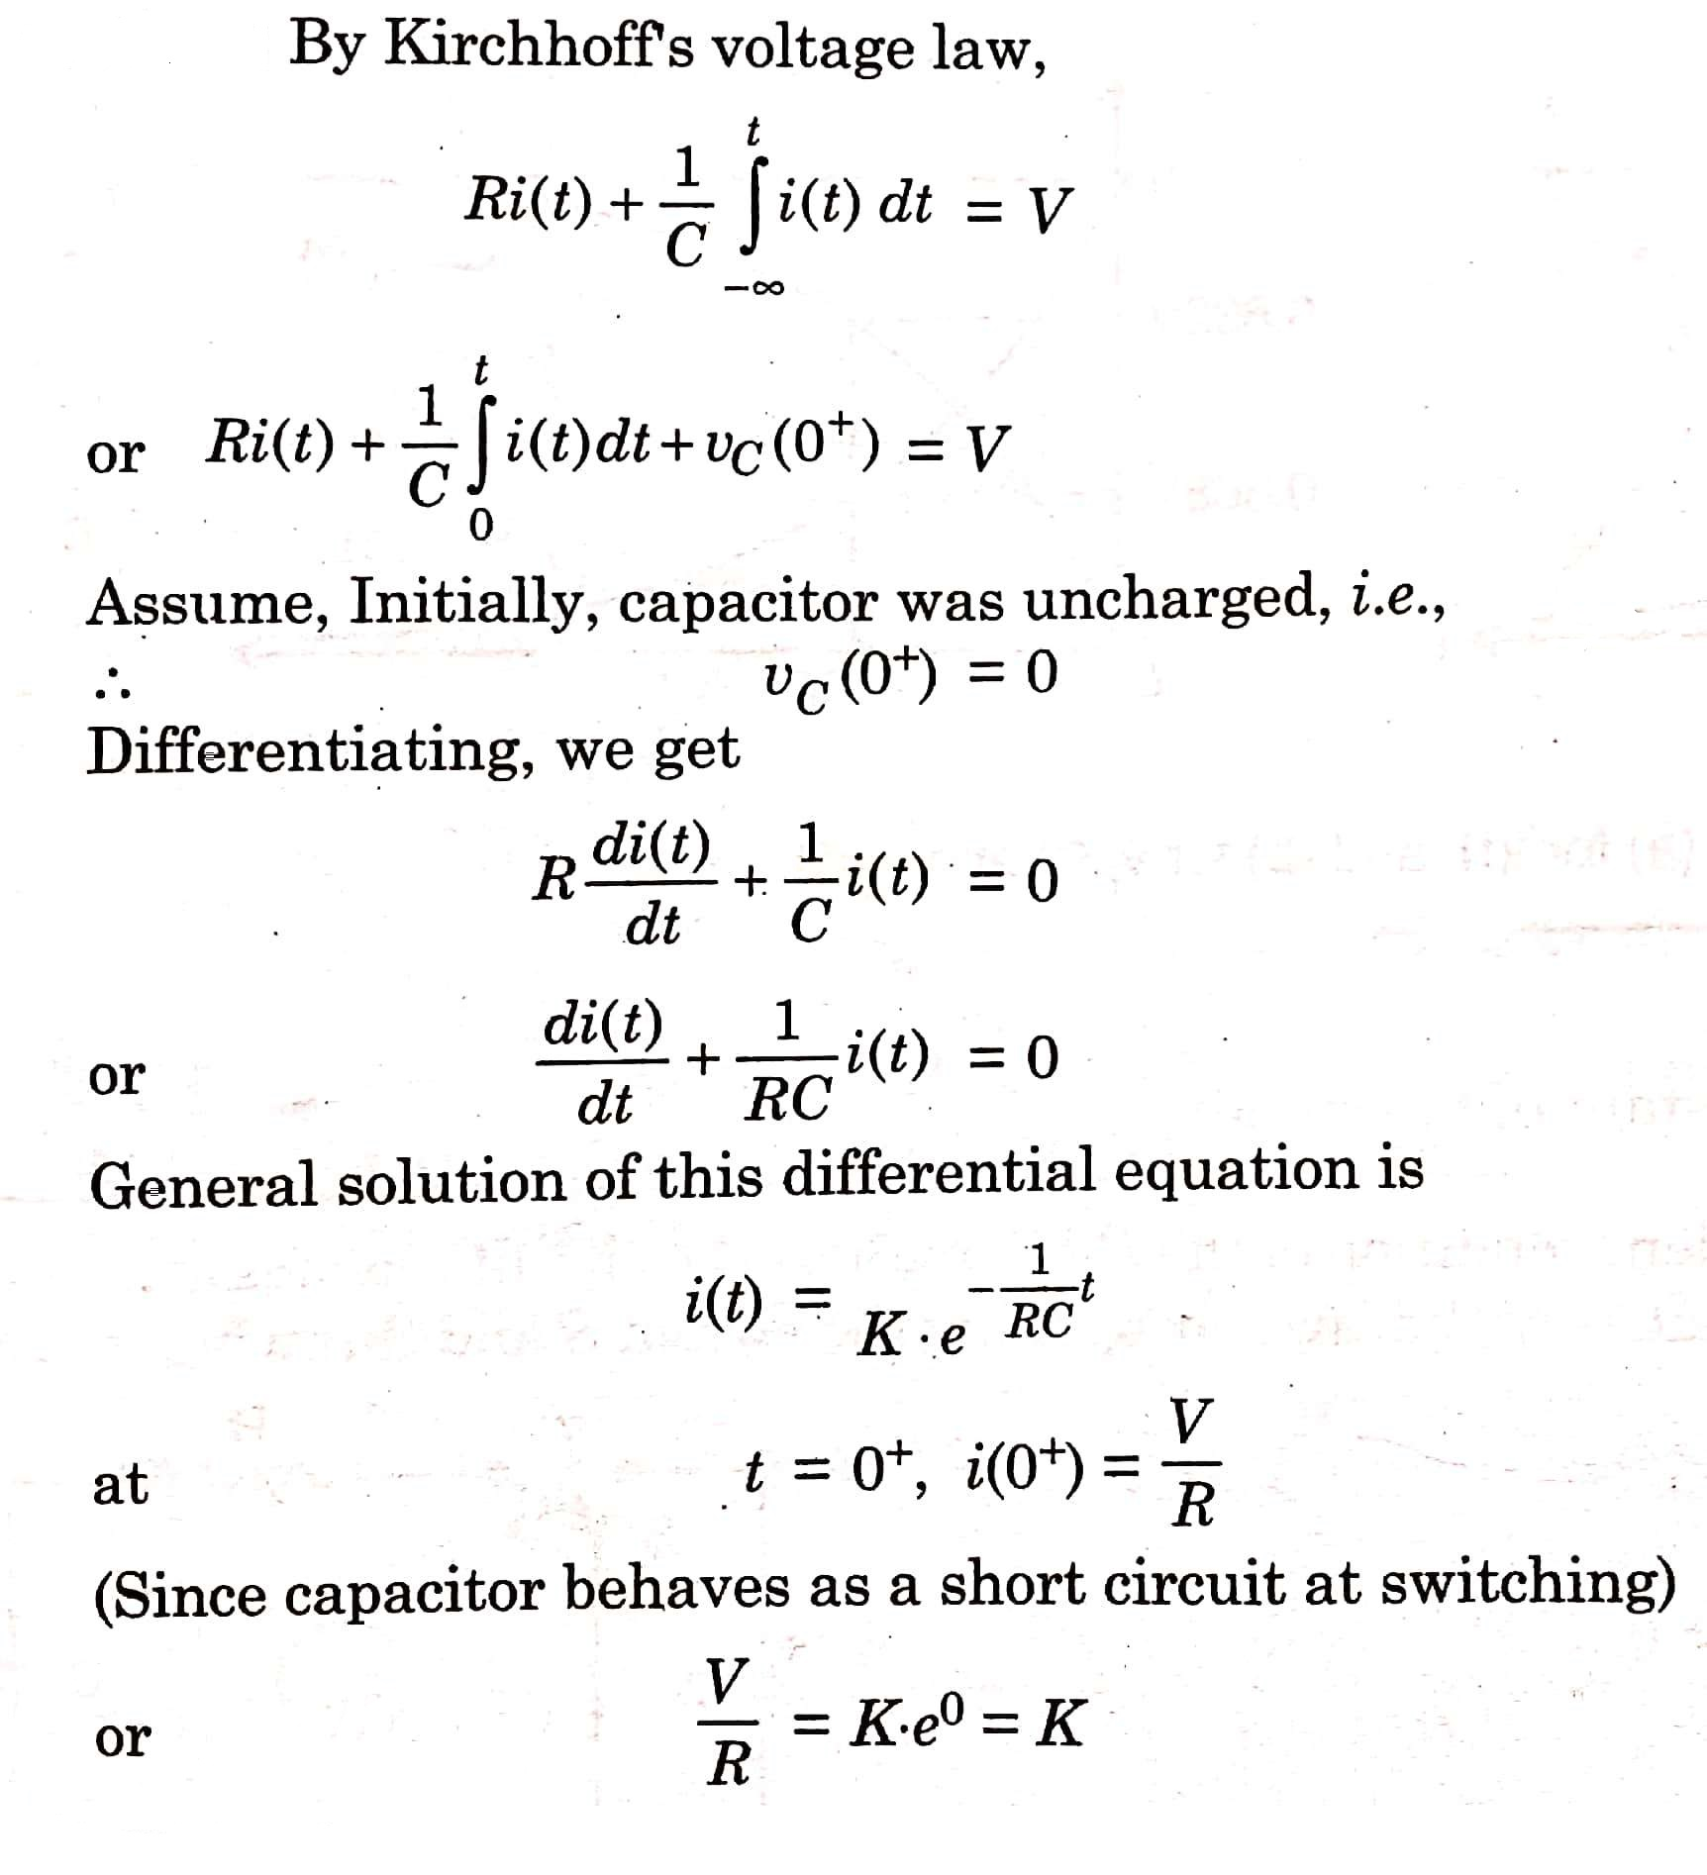

Slide 23
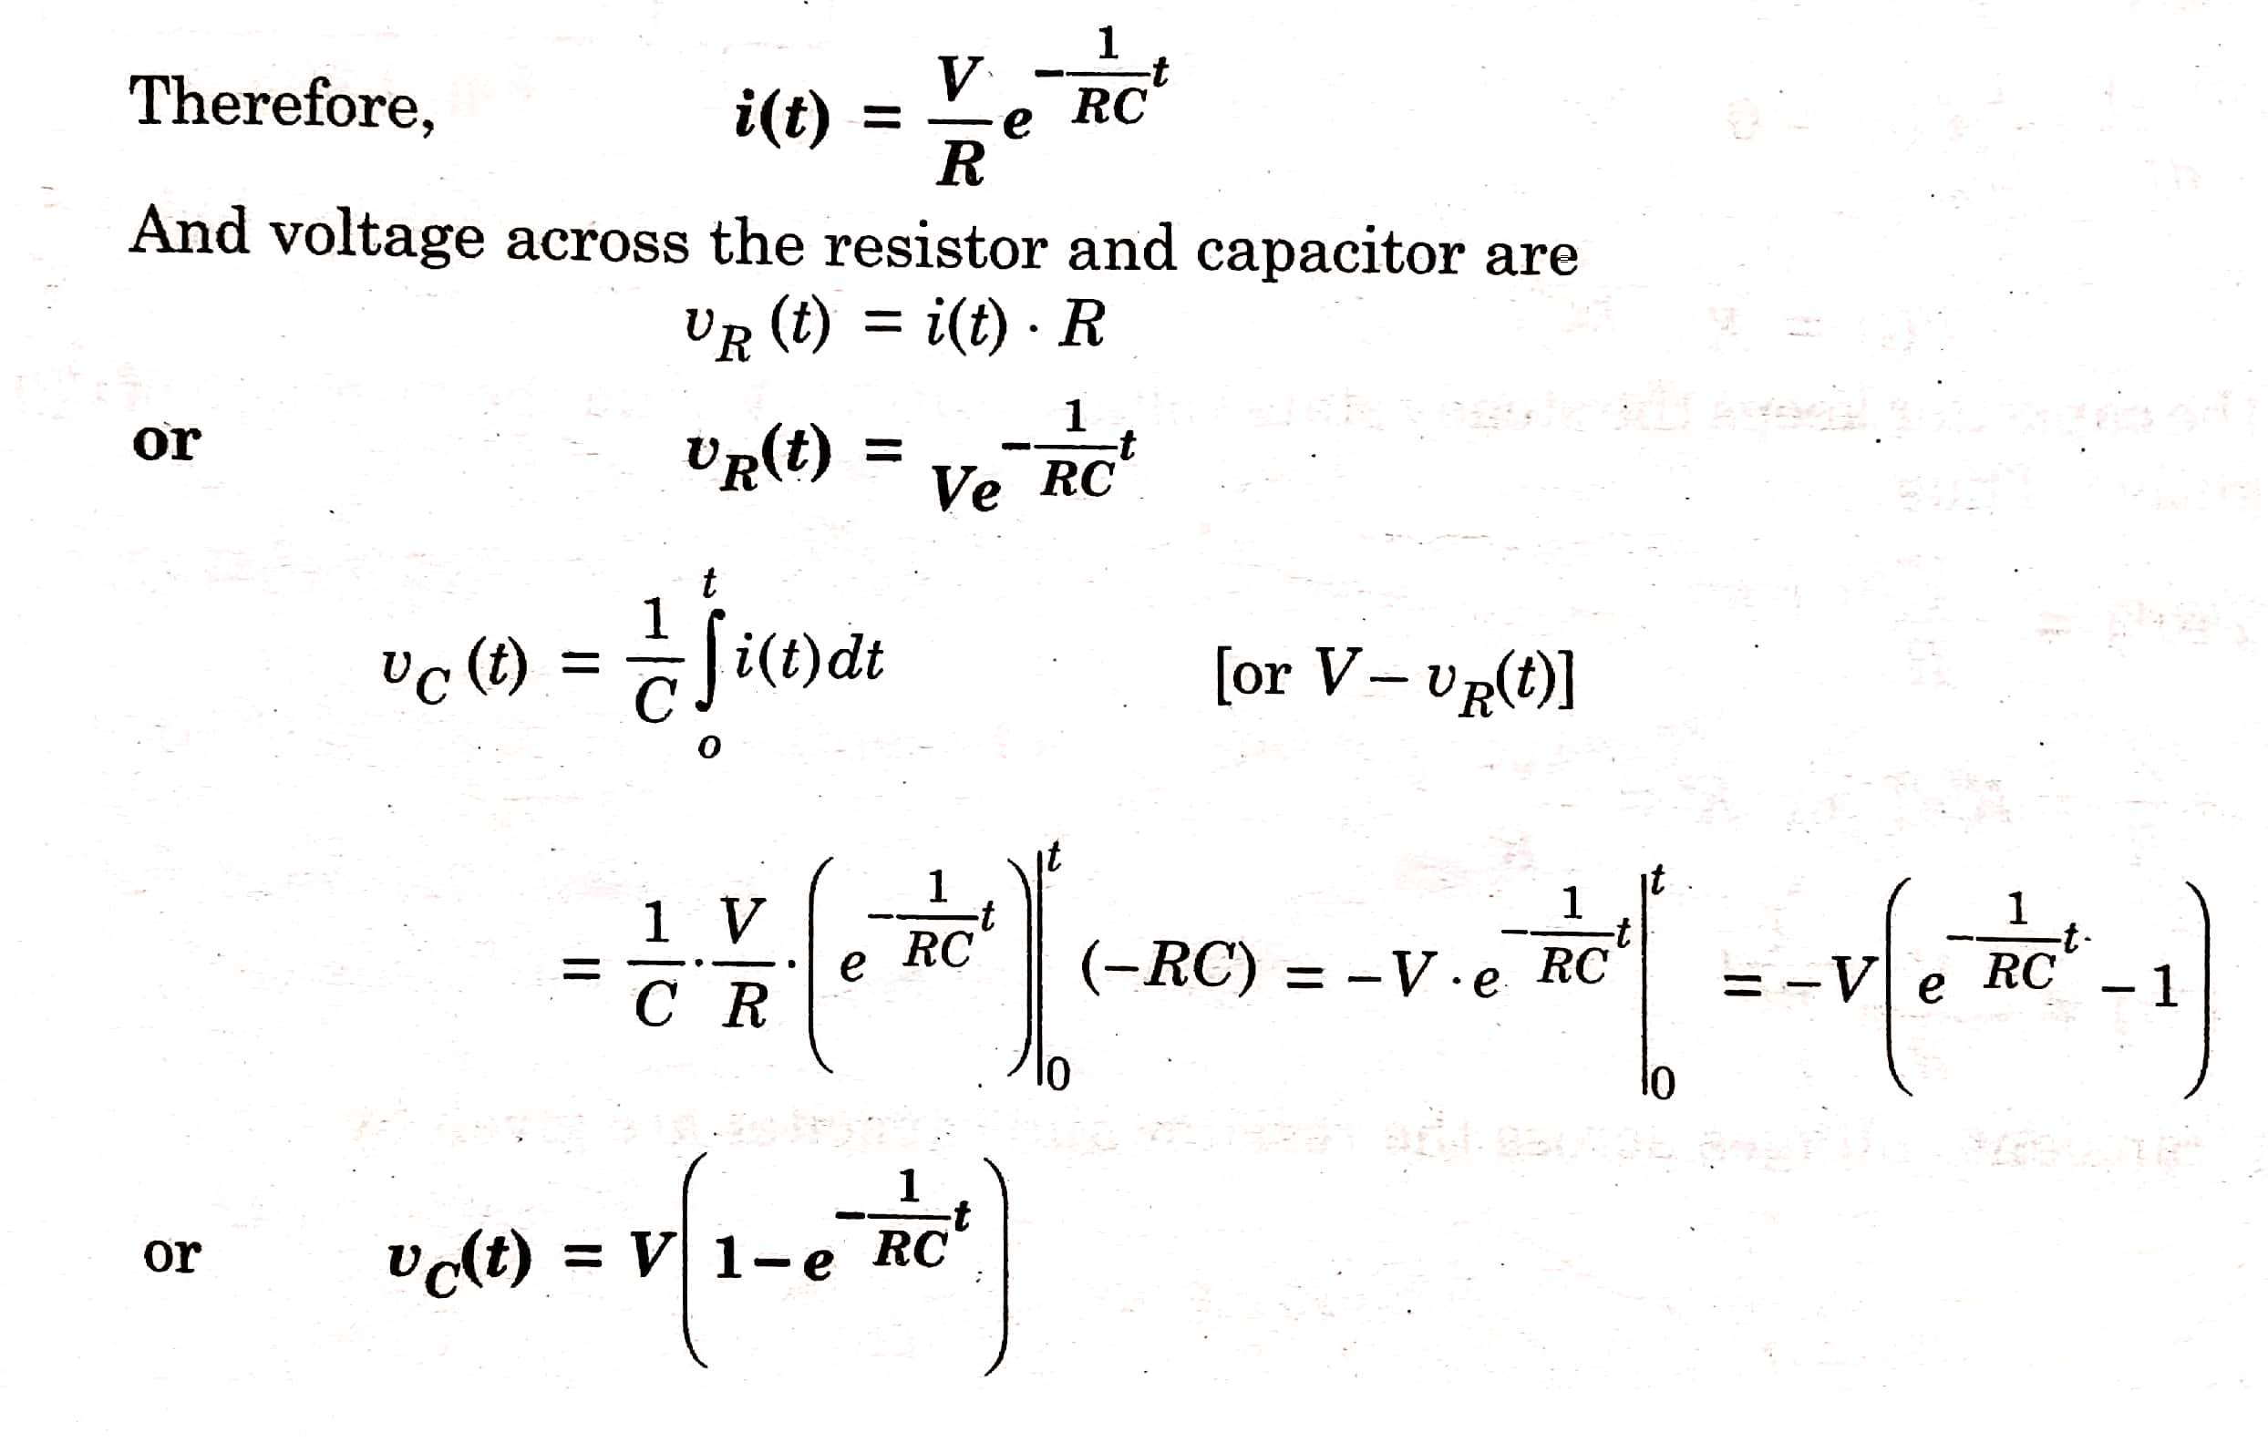

Slide 24
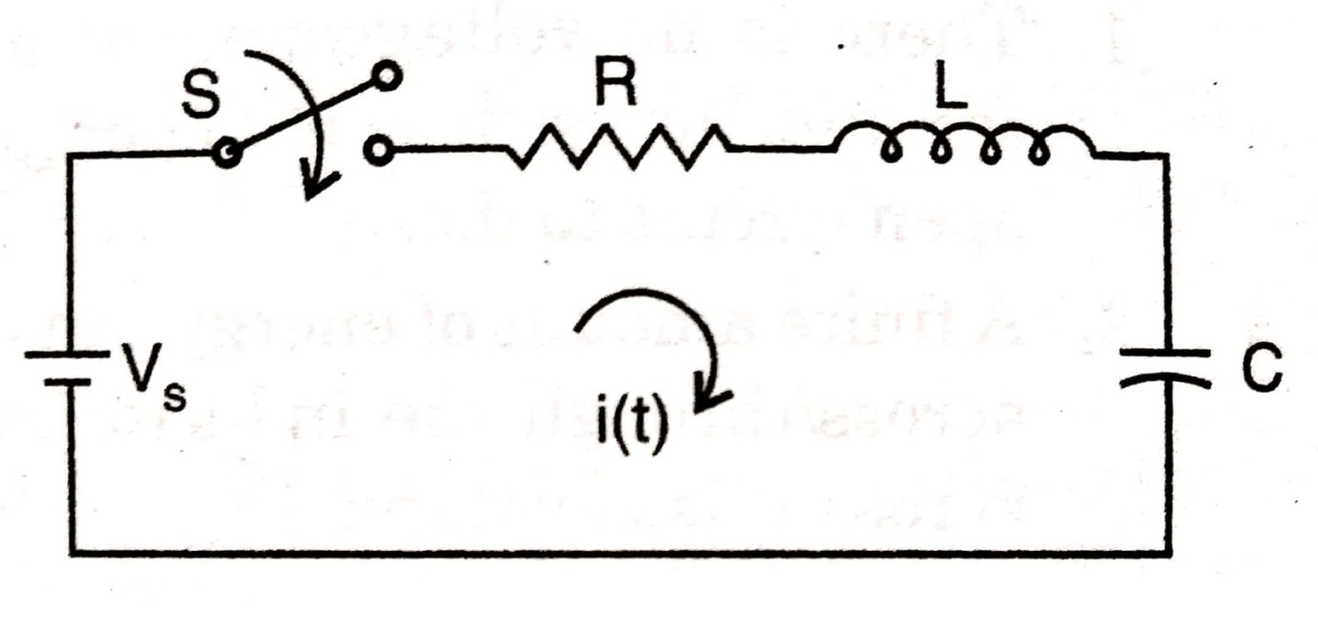
TRANSIENT RESPONSE OF R-L-C CIRCUIT HAVING DC EXCITATION
Ex 4) Consider the series R-L-C circuit shown in figure below. Given that;
V_{s} = 2 V; R = 6 Ω ; L = 2 H ; C = 0.25 F
Determine i(0⁺); di/dt(0⁺), d²i/dt²(0⁺) and i(t).

Slide 25
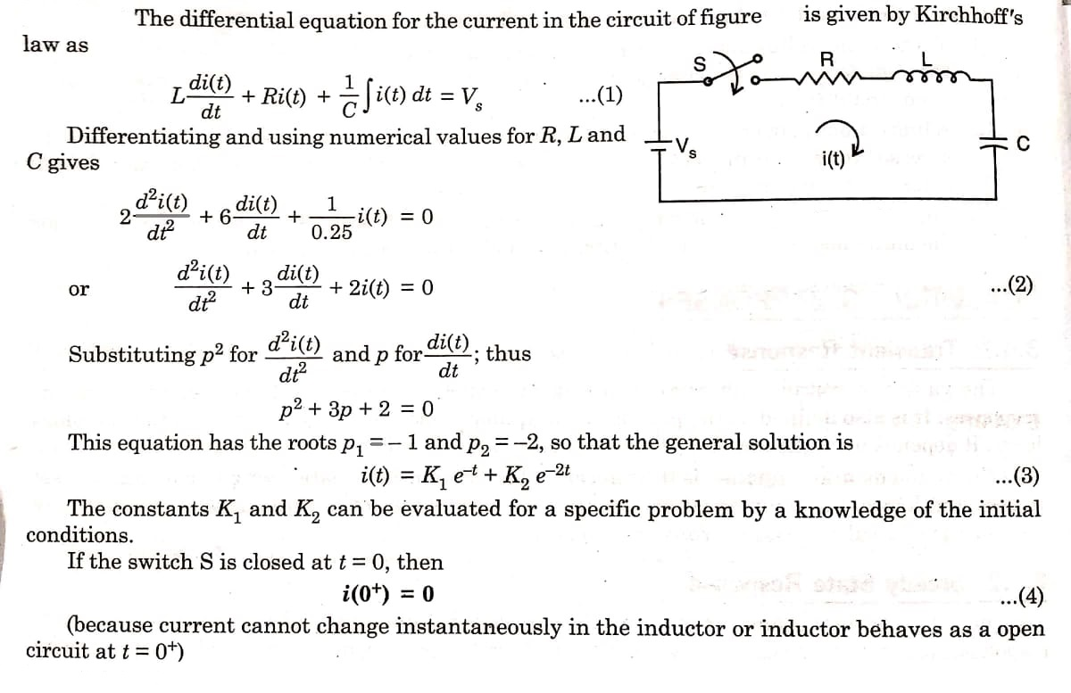

Slide 26
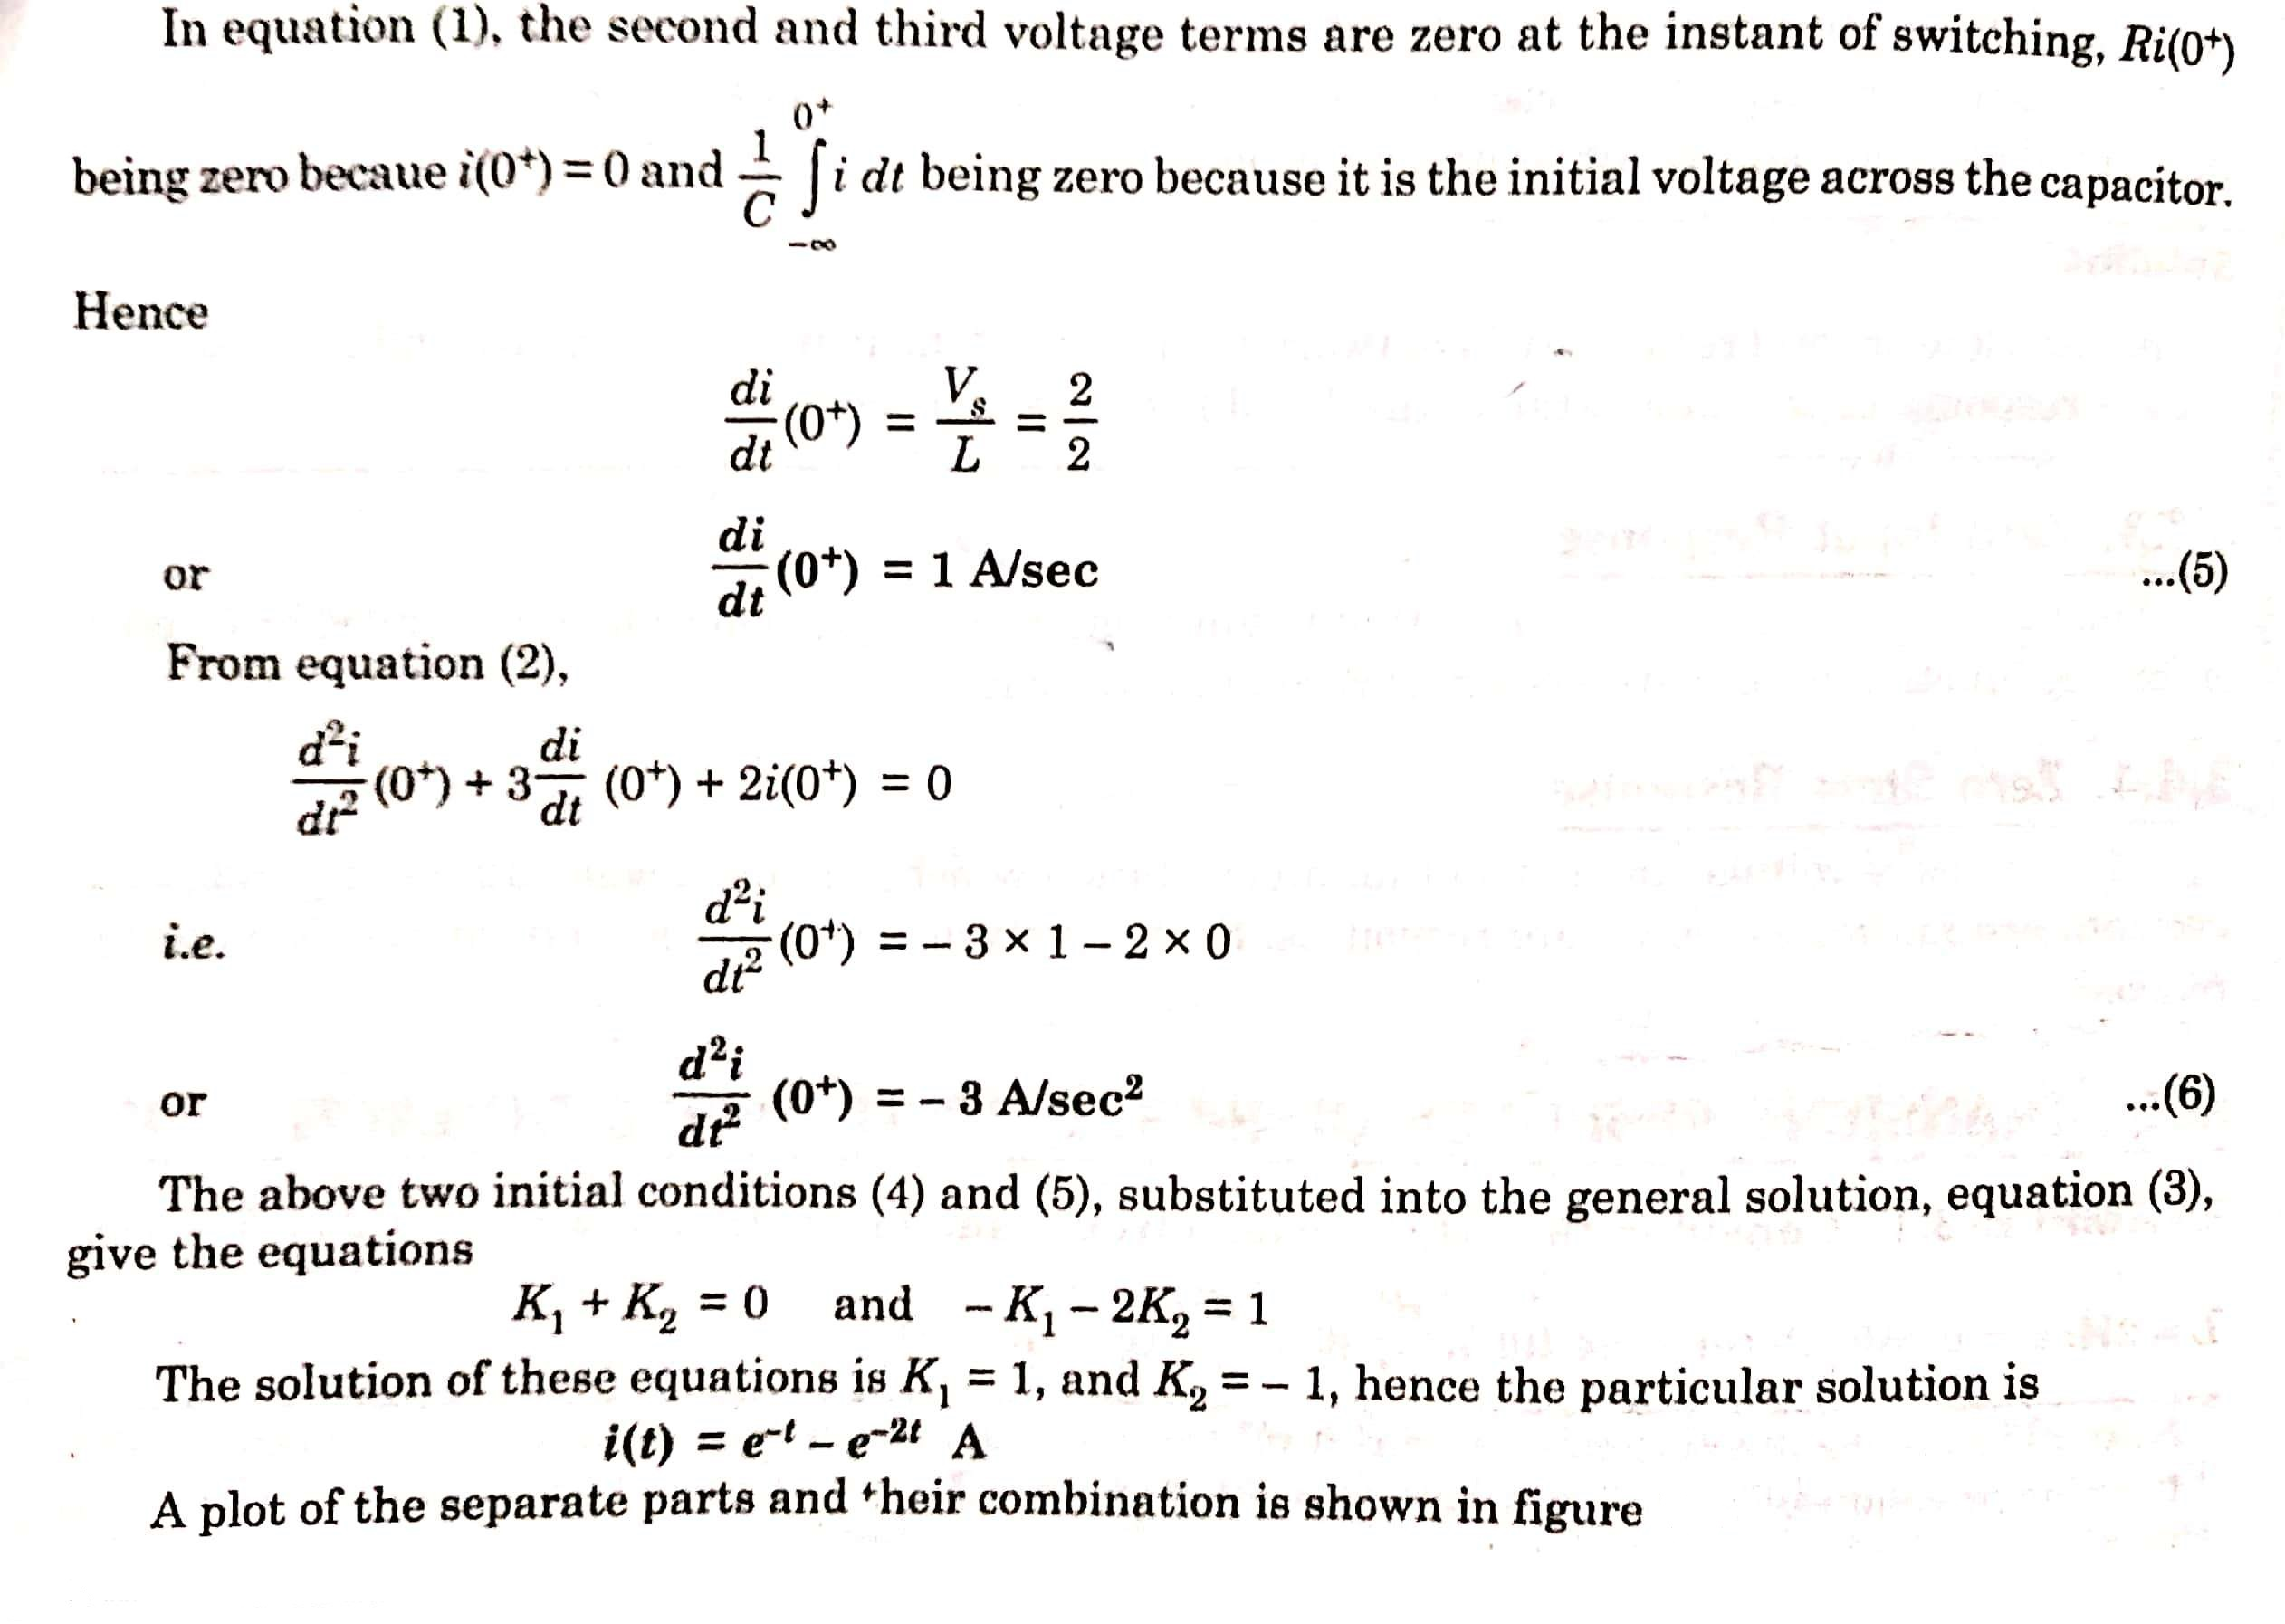

Slide 27
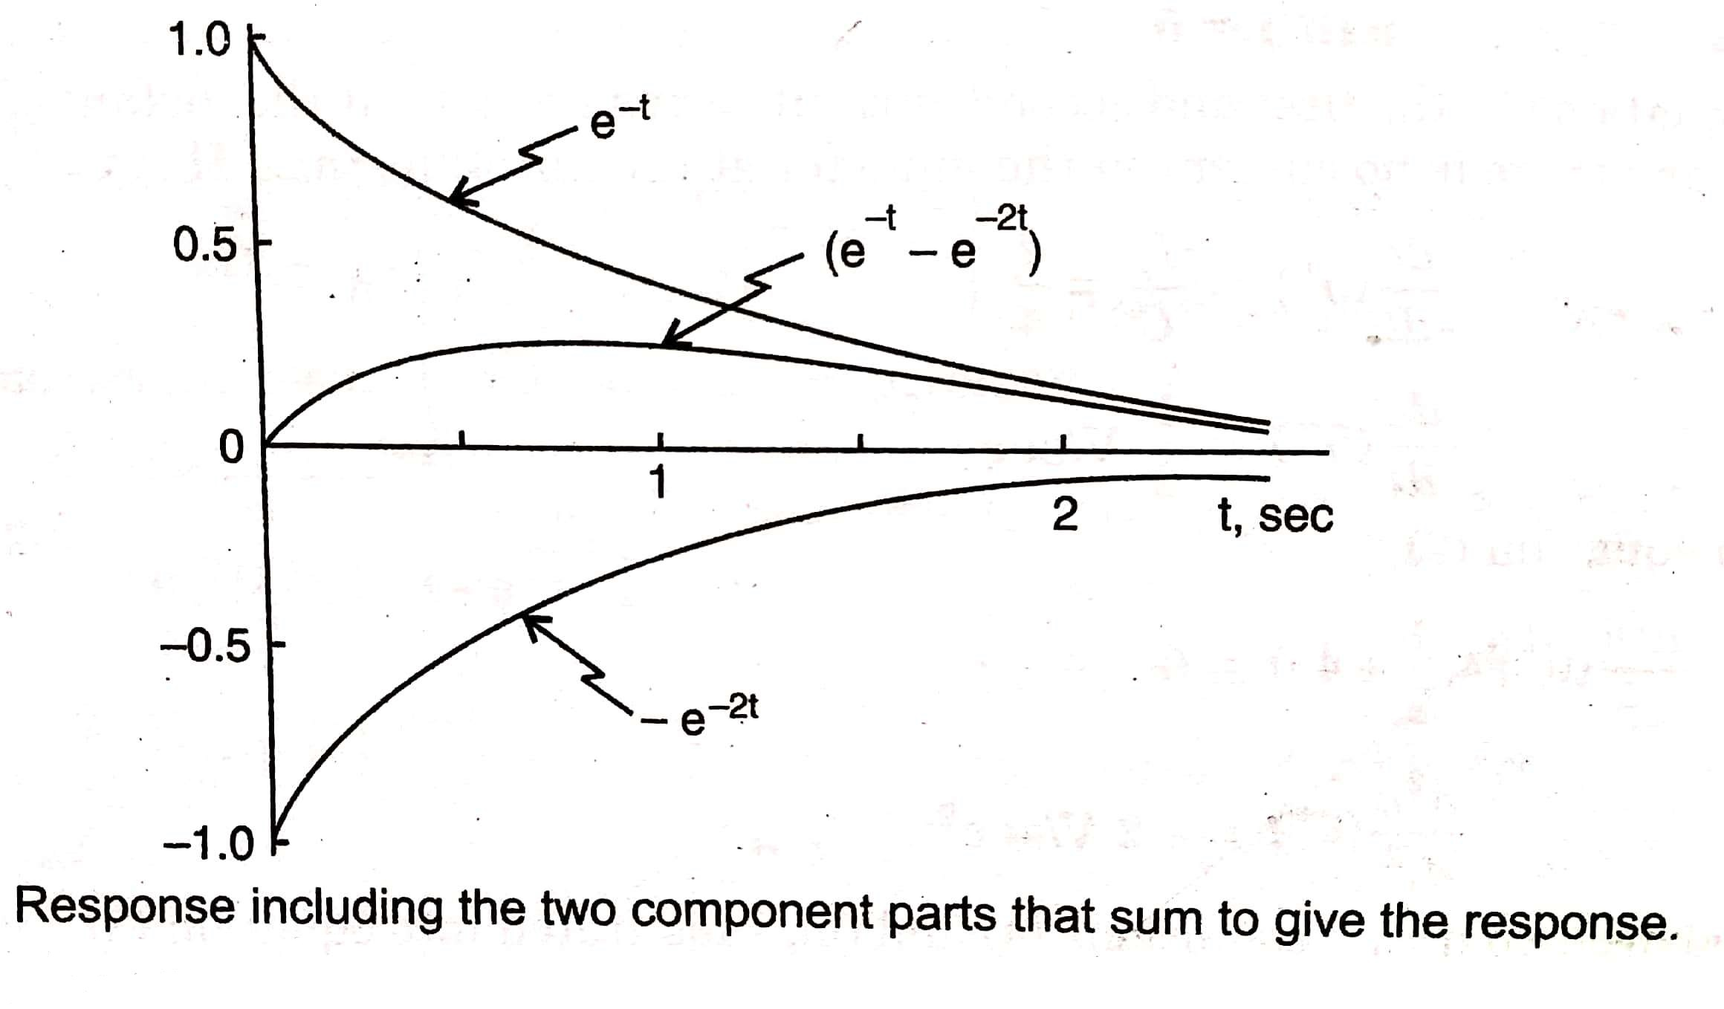

Slide 28
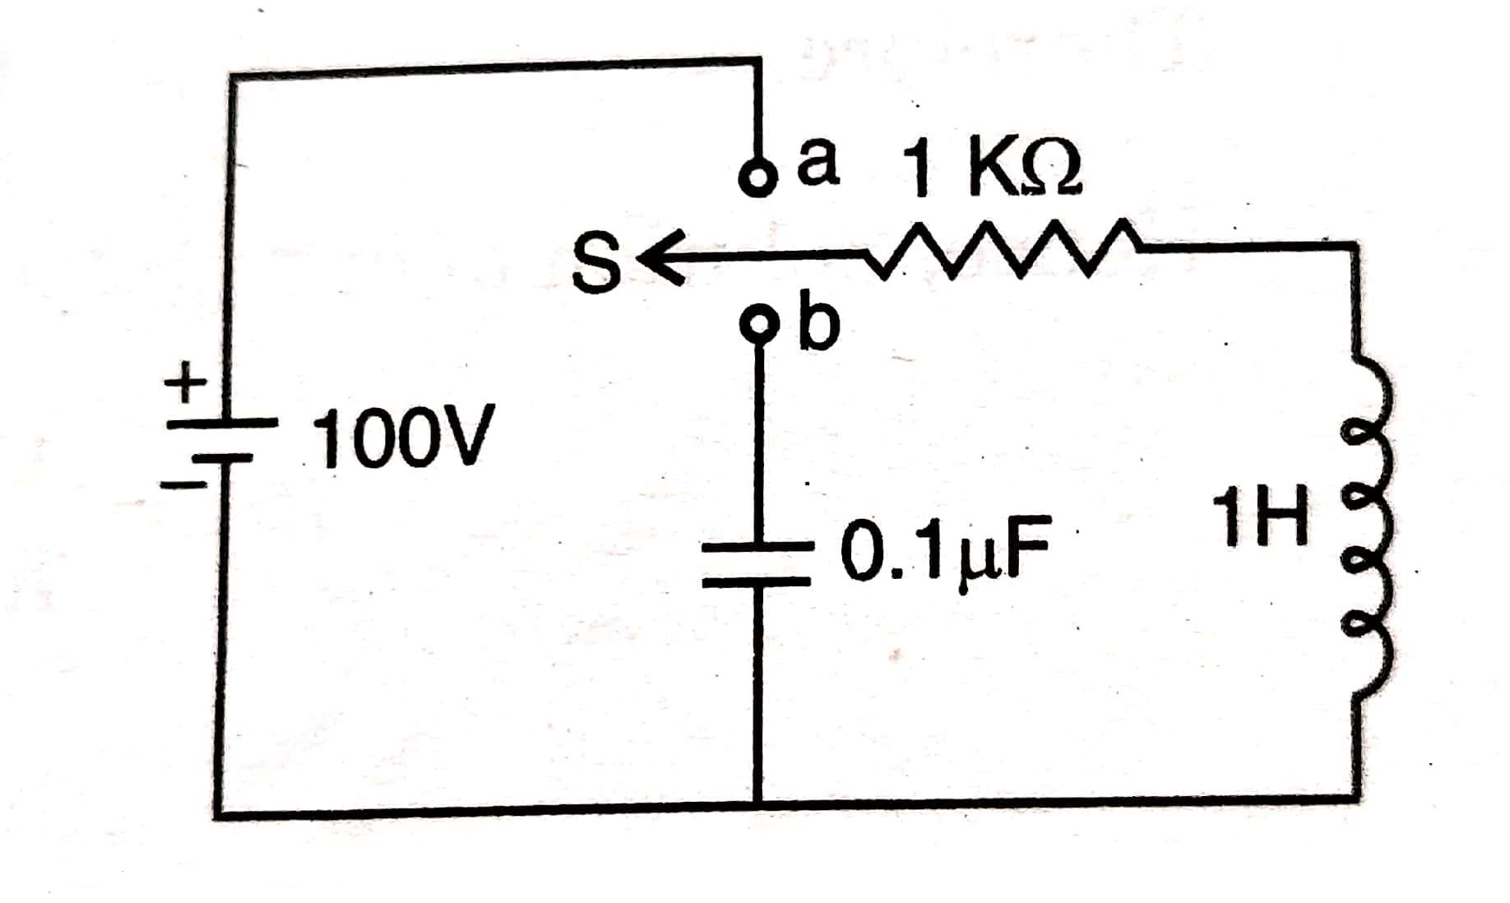
Ex 5) In the circuit shown in figure below, switch ‘S’ is changed from position ‘a’ to ‘b’ at t = 0 . Find the values of i, di/dt, and d²i/dt² at t = 0⁺

Slide 29
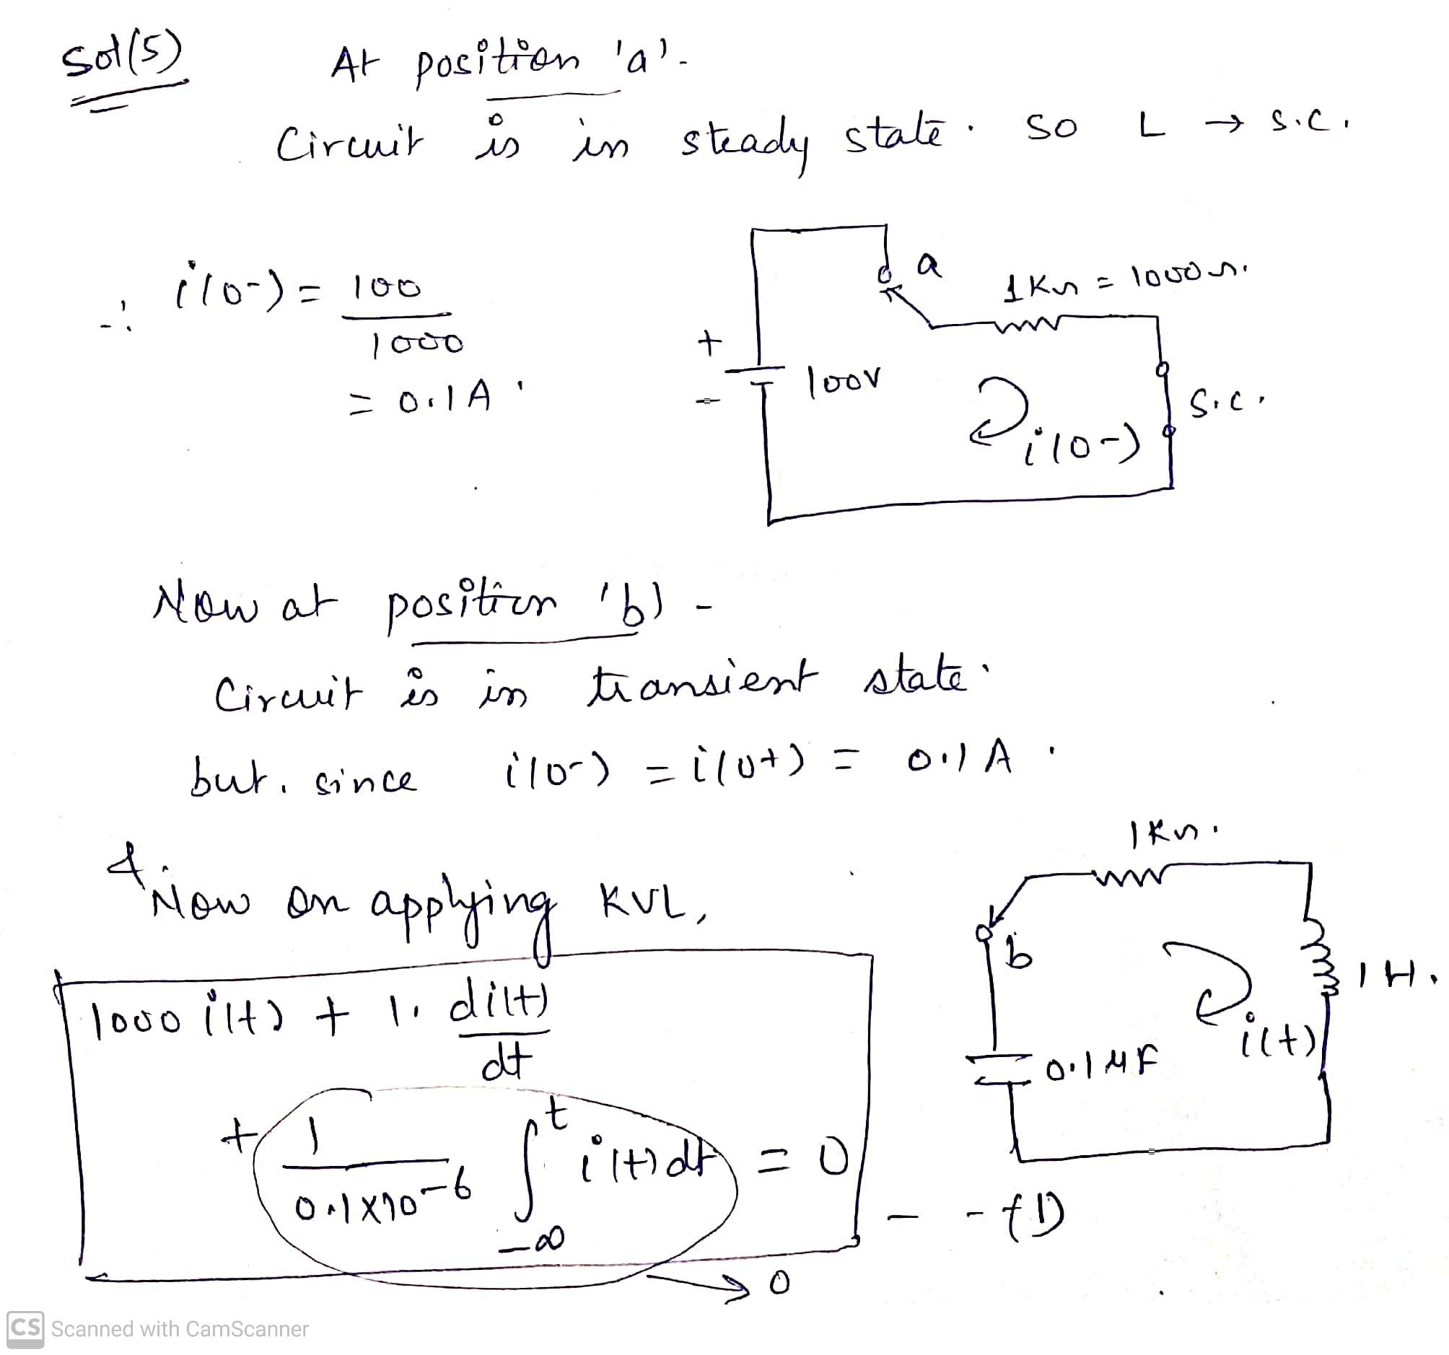

Slide 30
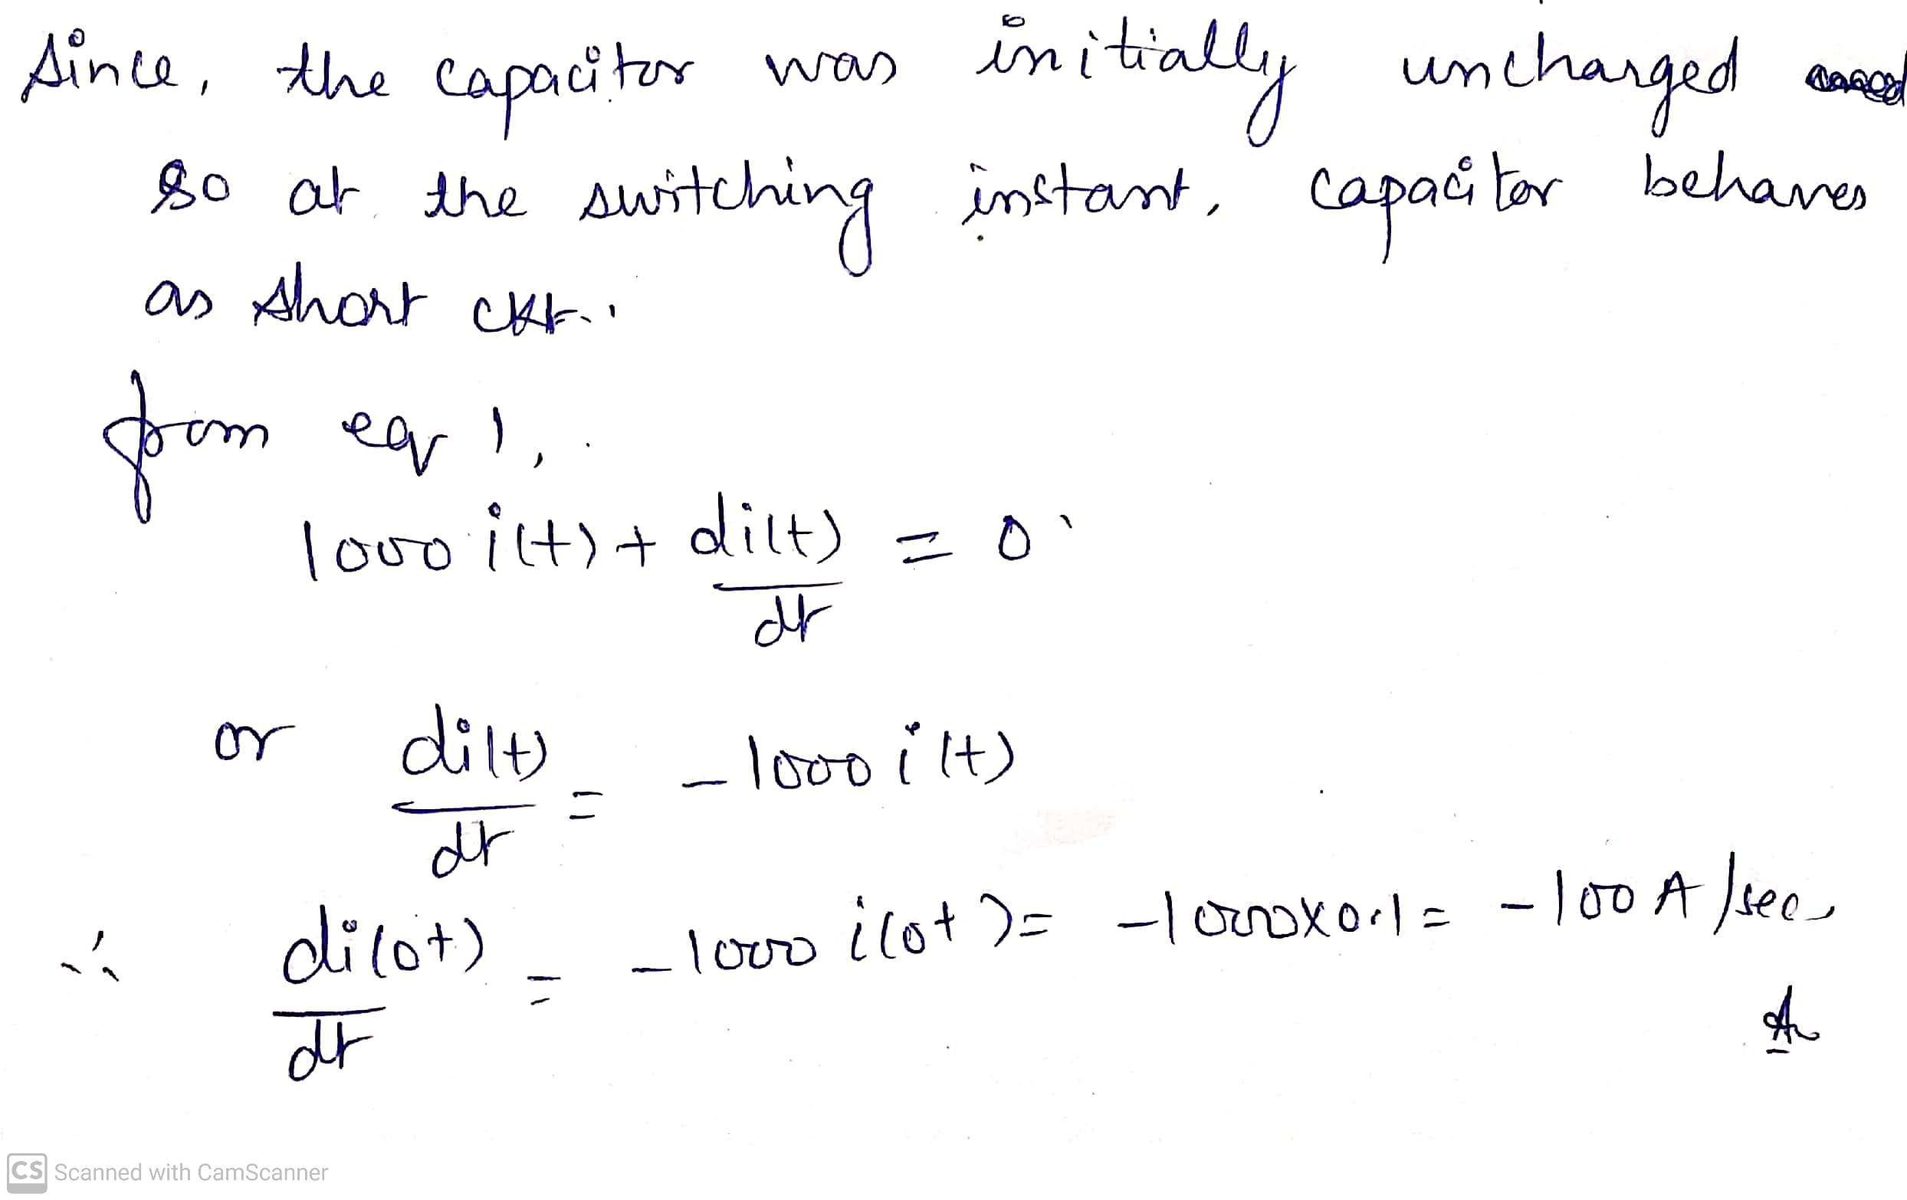

Slide 31
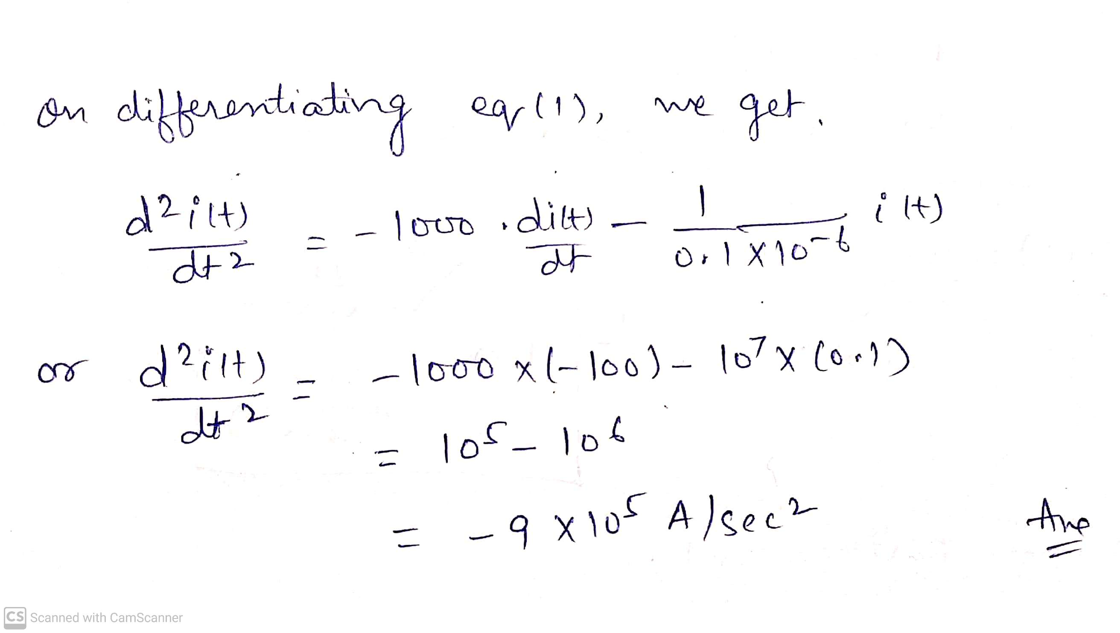

Slide 32
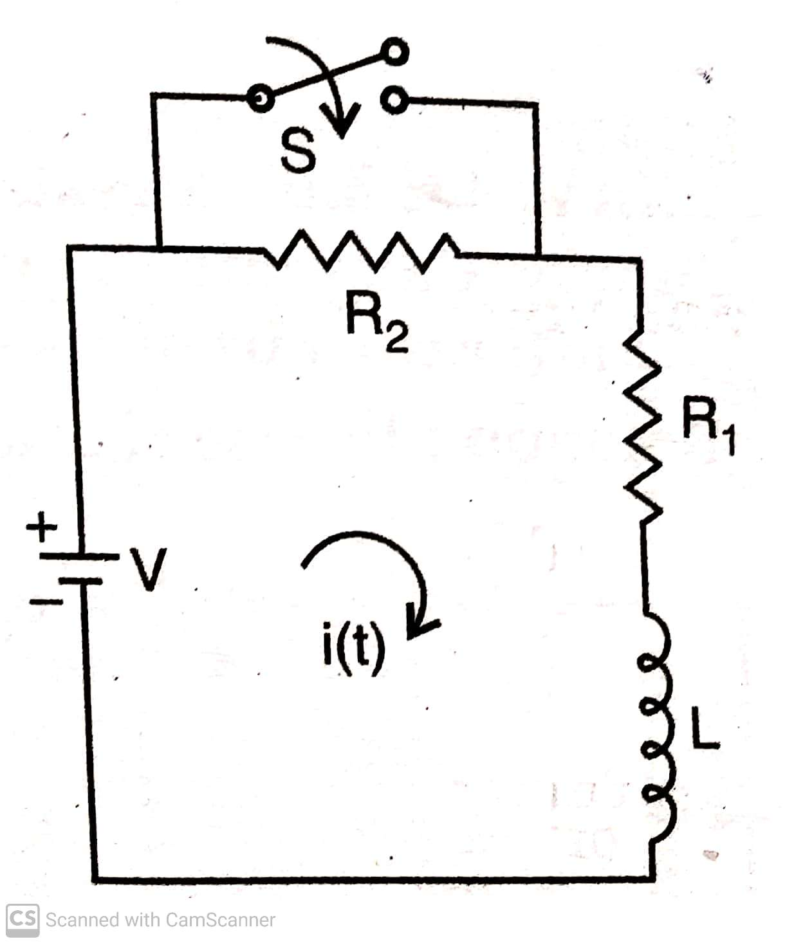
Ex 6) In the network shown in fig below , switch ‘S’ is closed at t = 0, a steady state current having previously been attained. Solve for the current as a function of time.

Slide 33
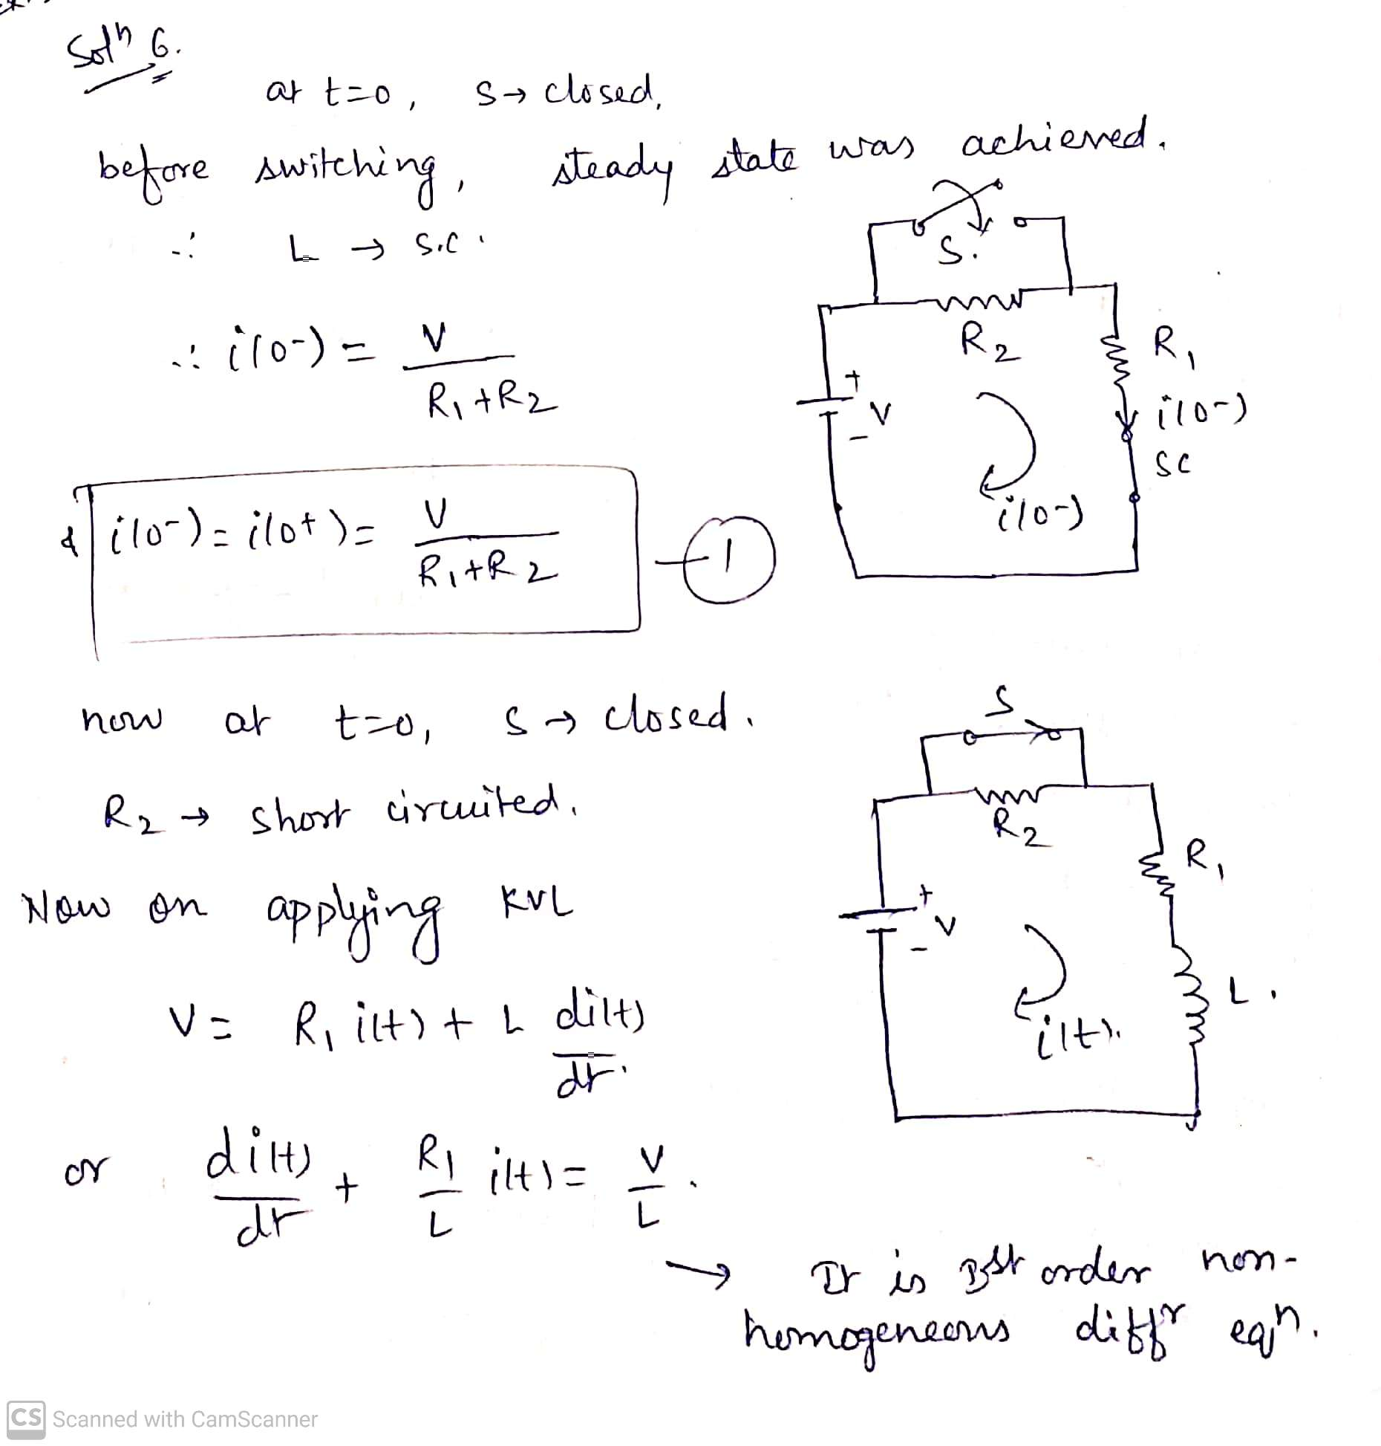

Slide 34
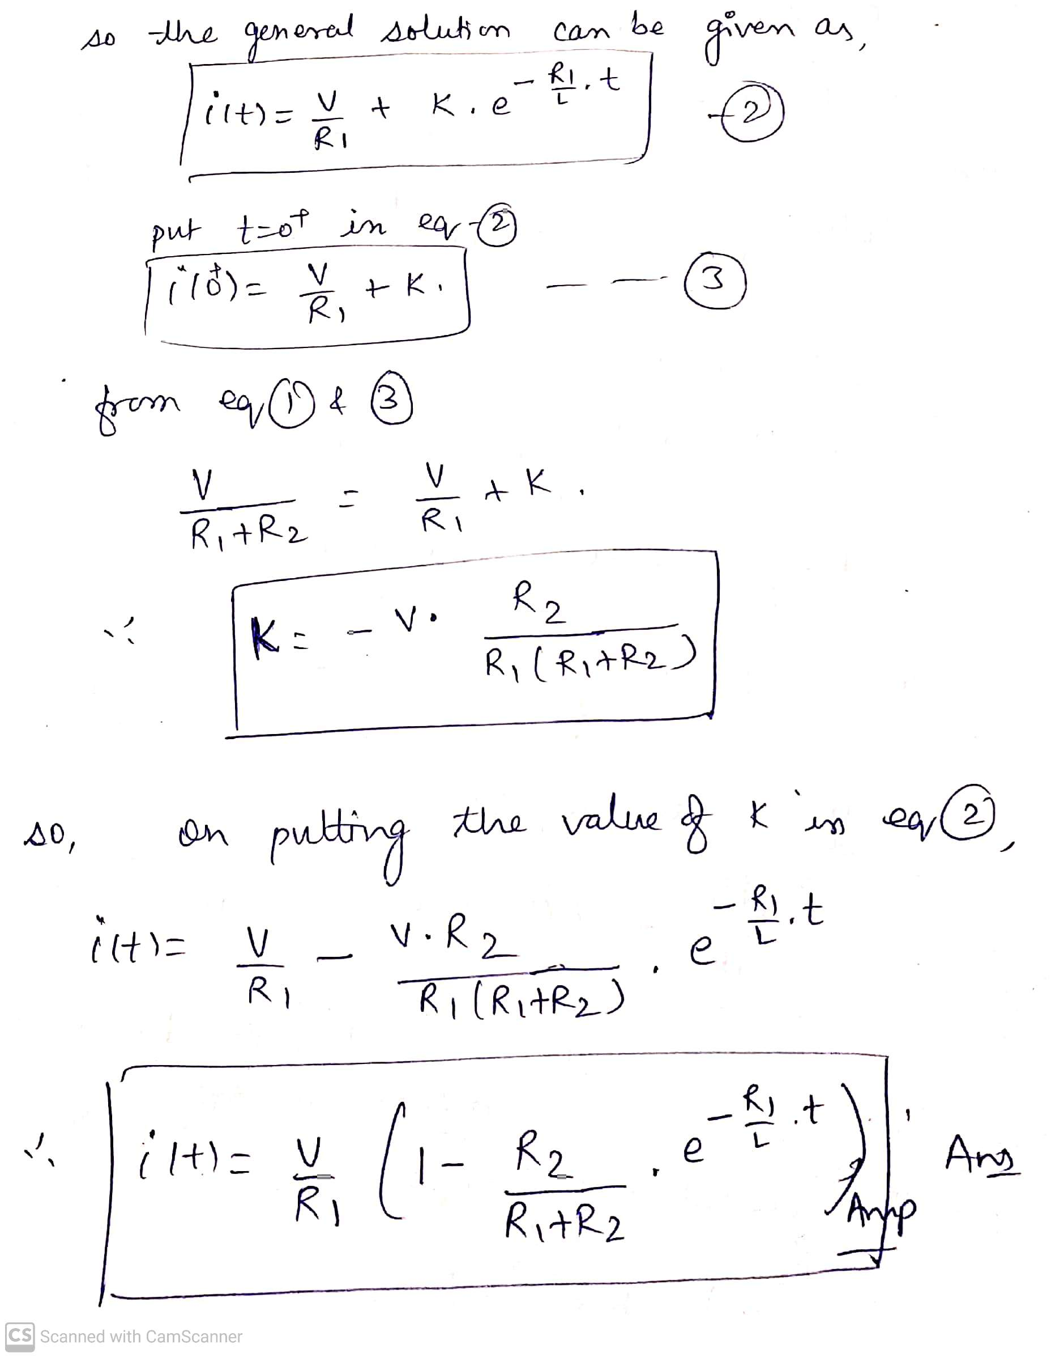

Slide 35
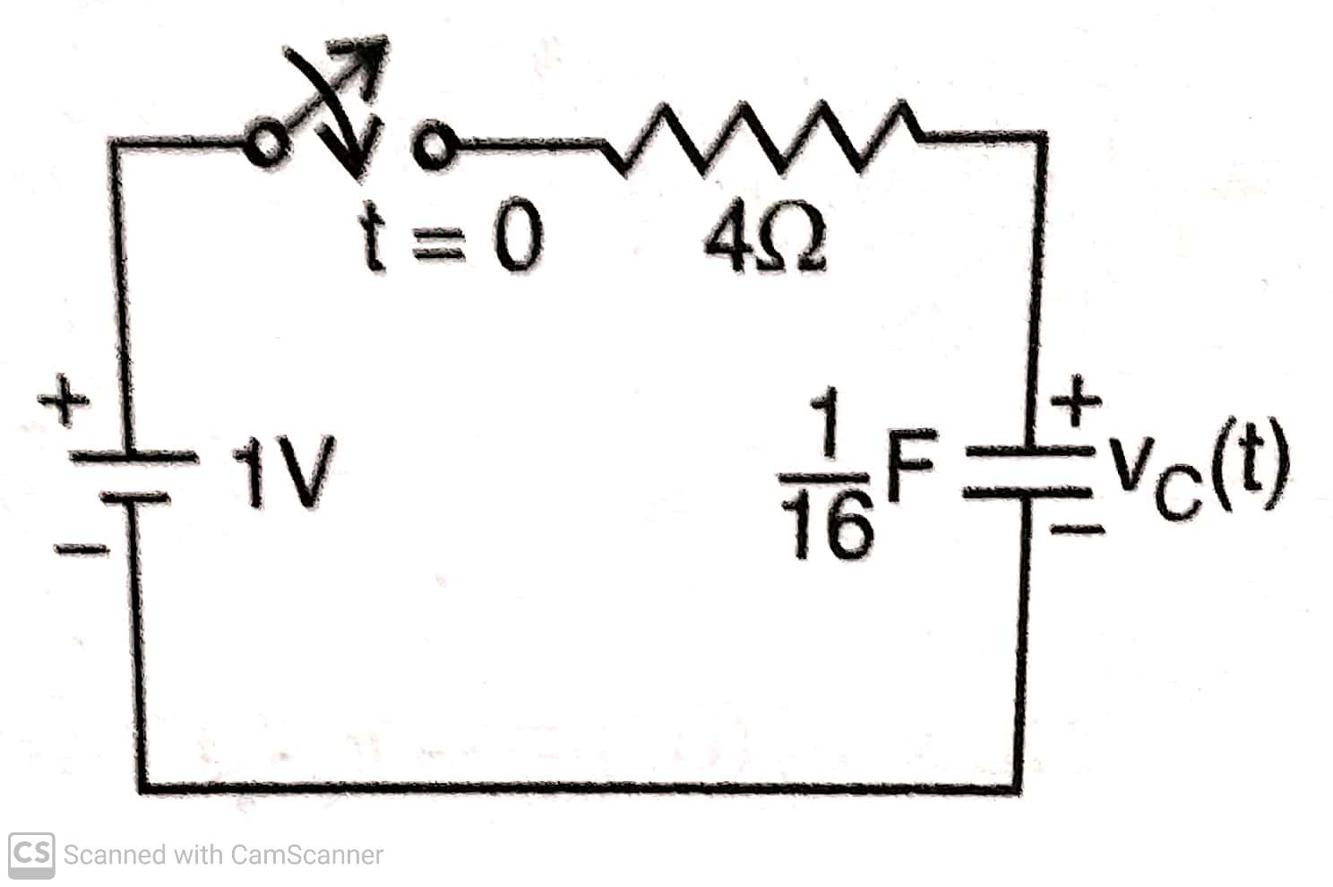
Ex 7) Using classical method of solution of differential equations, find the value of v_{c} (t) for t > 0 in the circuit shown in figure below. Assume initial condition v_{c} (0⁻) = 9 V.

Slide 36
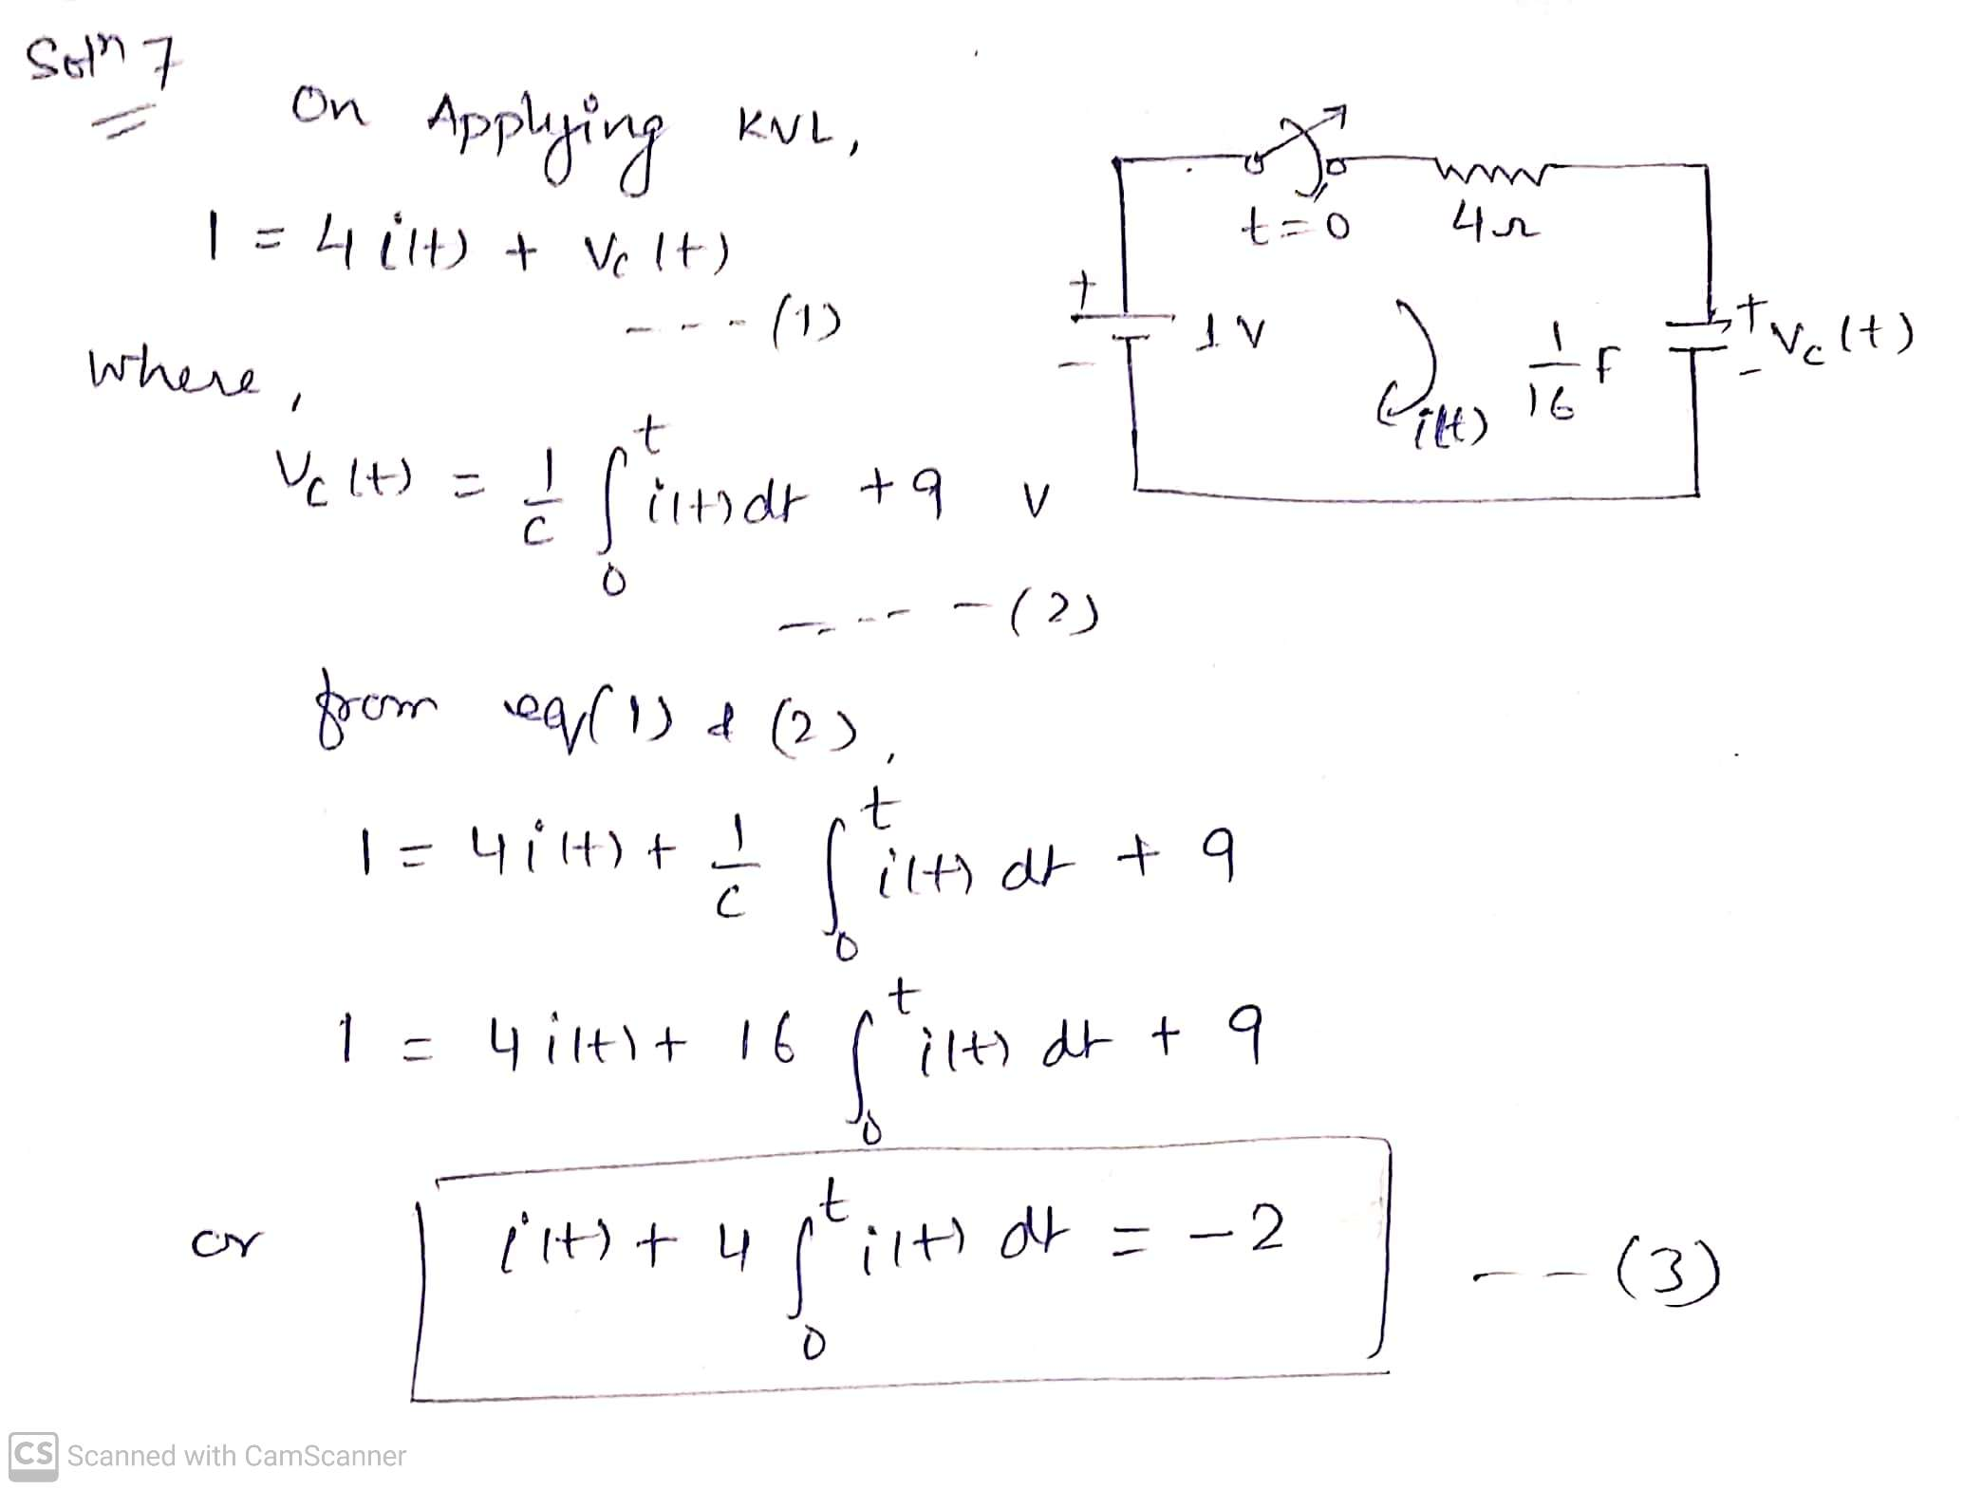

Slide 37
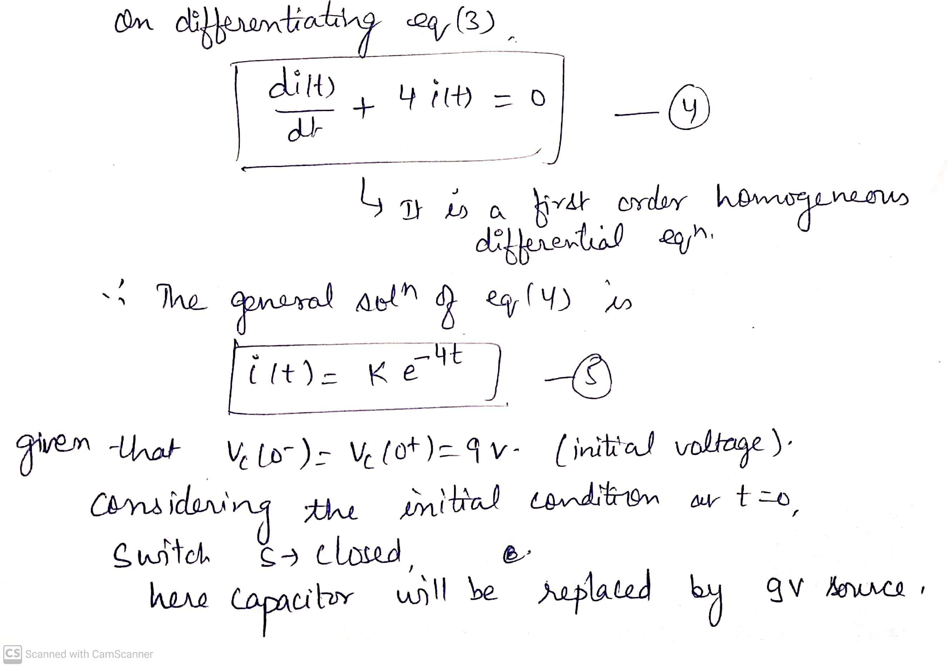

Slide 38
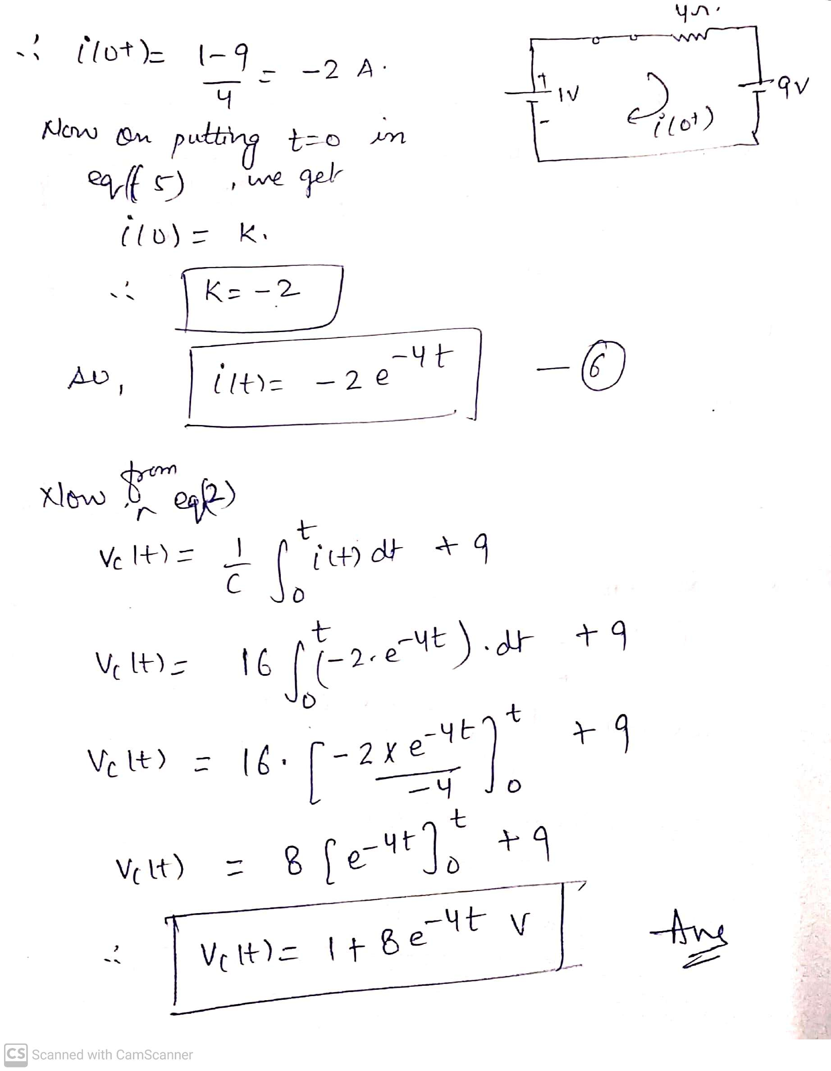

Slide 39
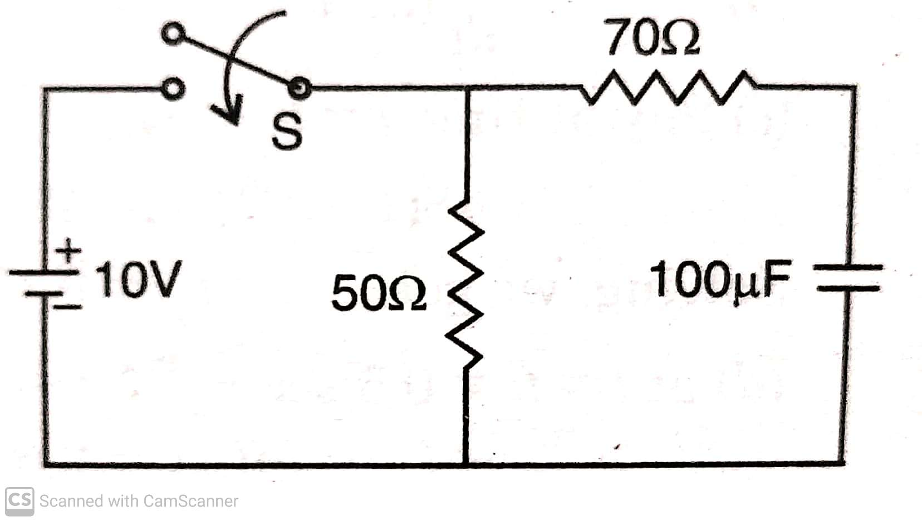
Ex 8) In the fig shown below, the switch ‘S’ is closed at t = 0. Find the time when the current from the battery reaches to 500 mA.

Slide 40
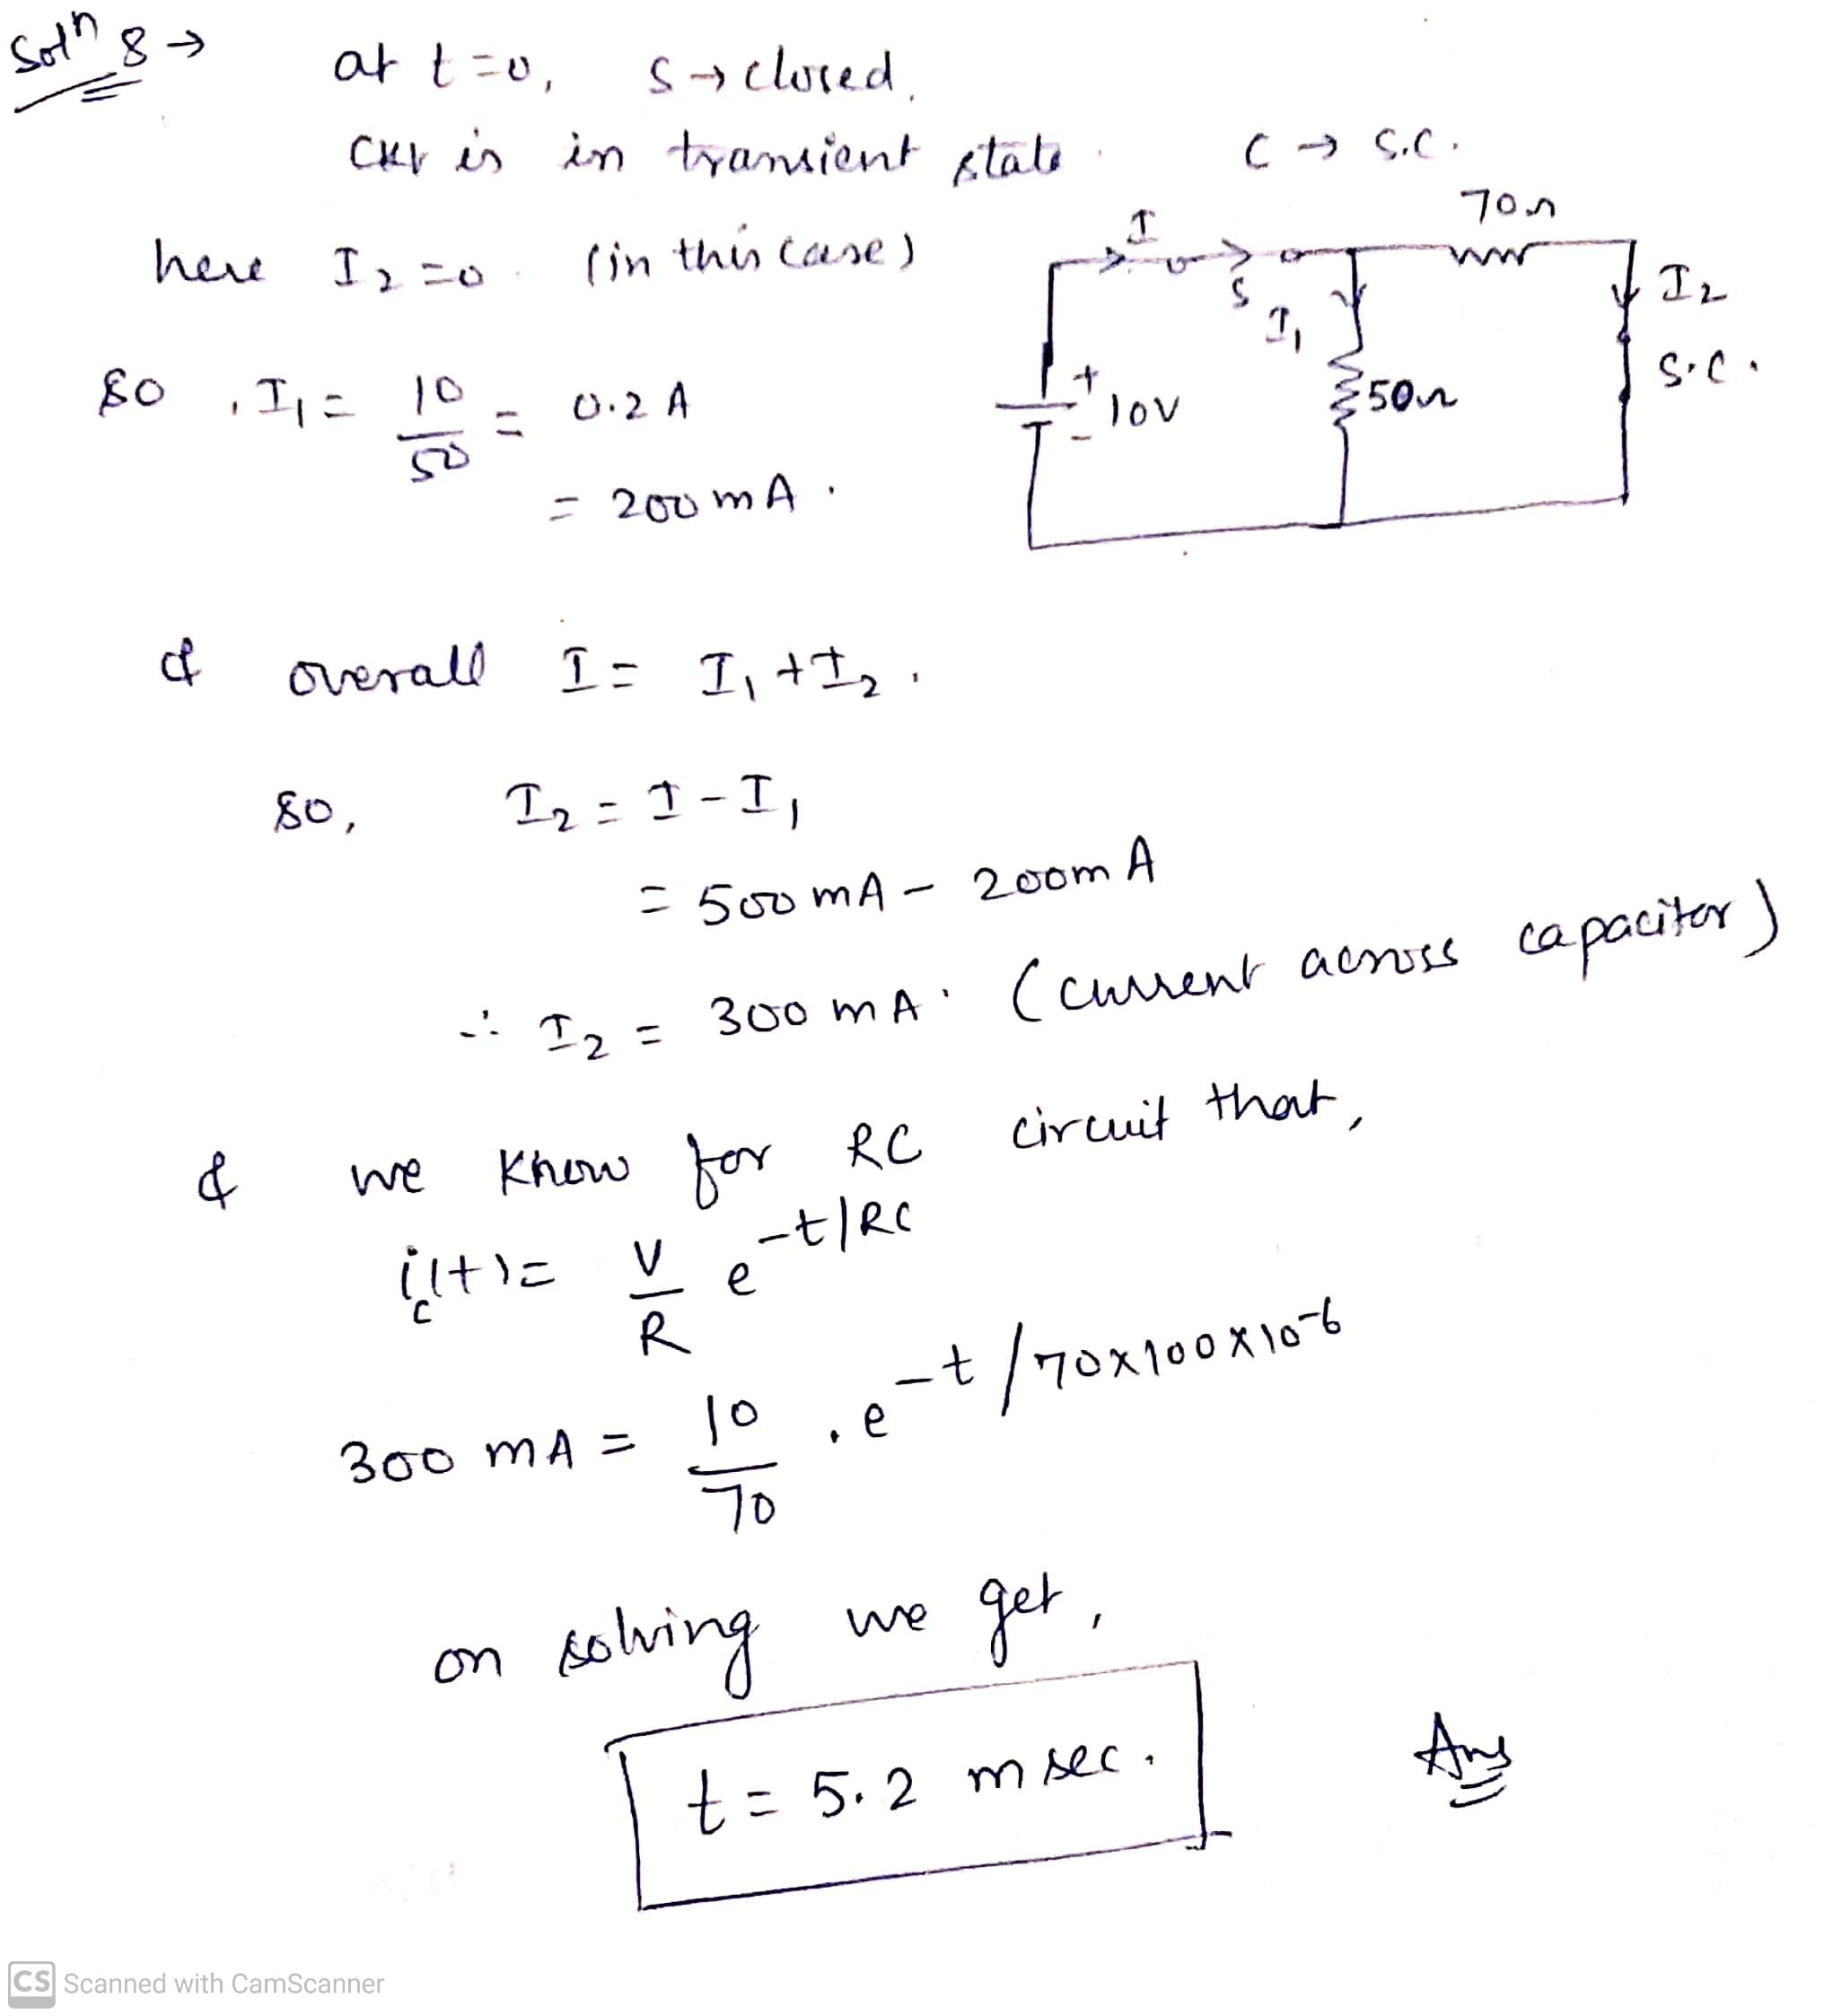

Slide 41
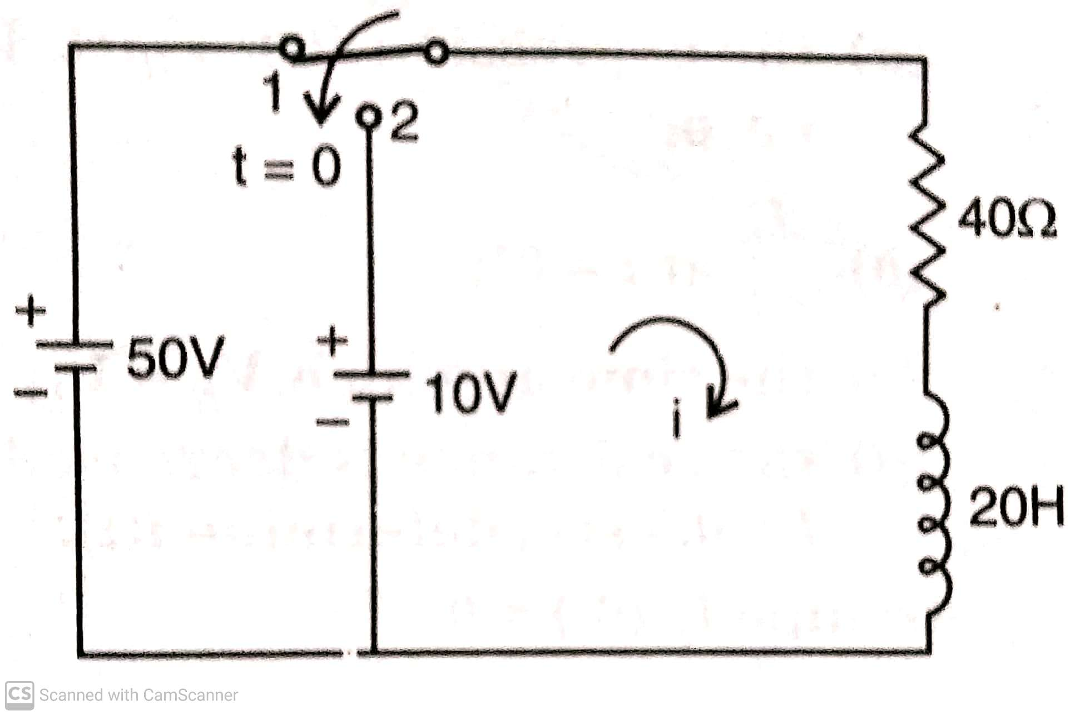
Ex 9) In the fig shown below, the switch has been in position ‘1’ for a long time. It is moved to position ‘2’ at t = 0 . Obtain the expression for the current for t > 0.

Slide 42
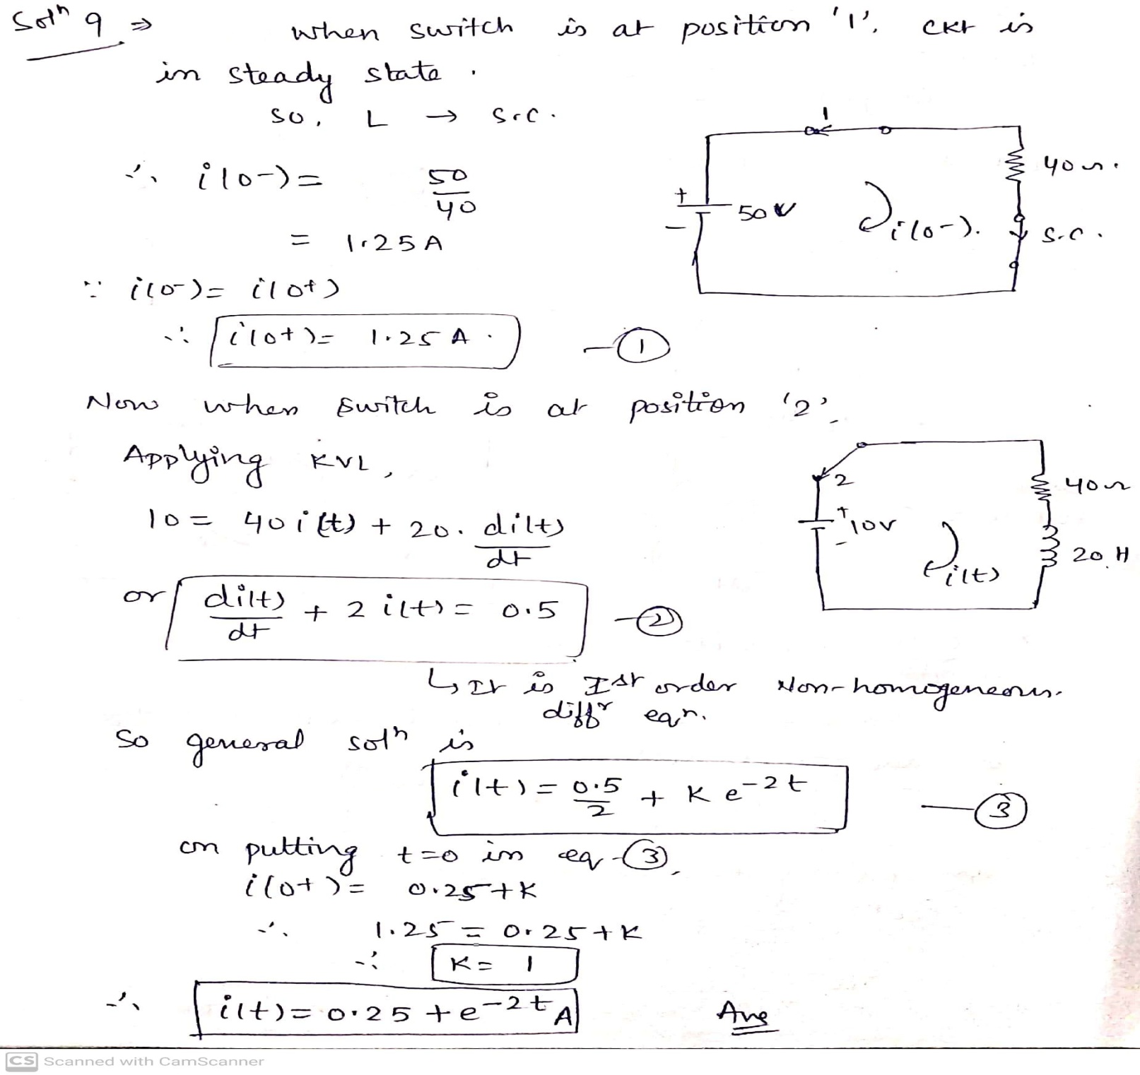

Slide 43
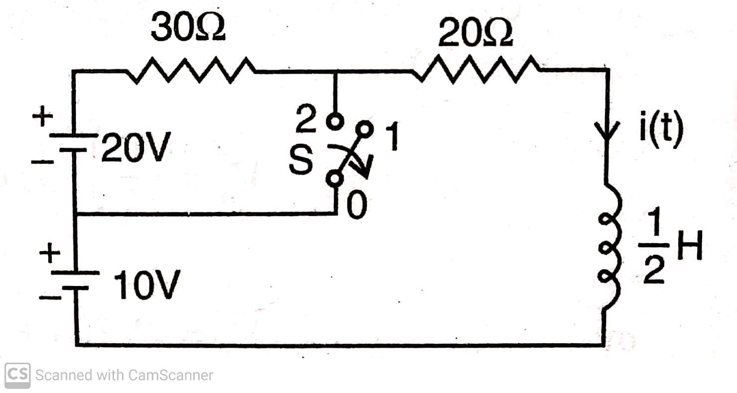
Ex 10) The circuit shown in fig below reaches a steady state in position ‘2’ and at t = 0 the switch ‘S’ is moved to position ‘1’. Find the current i(t).

Slide 44
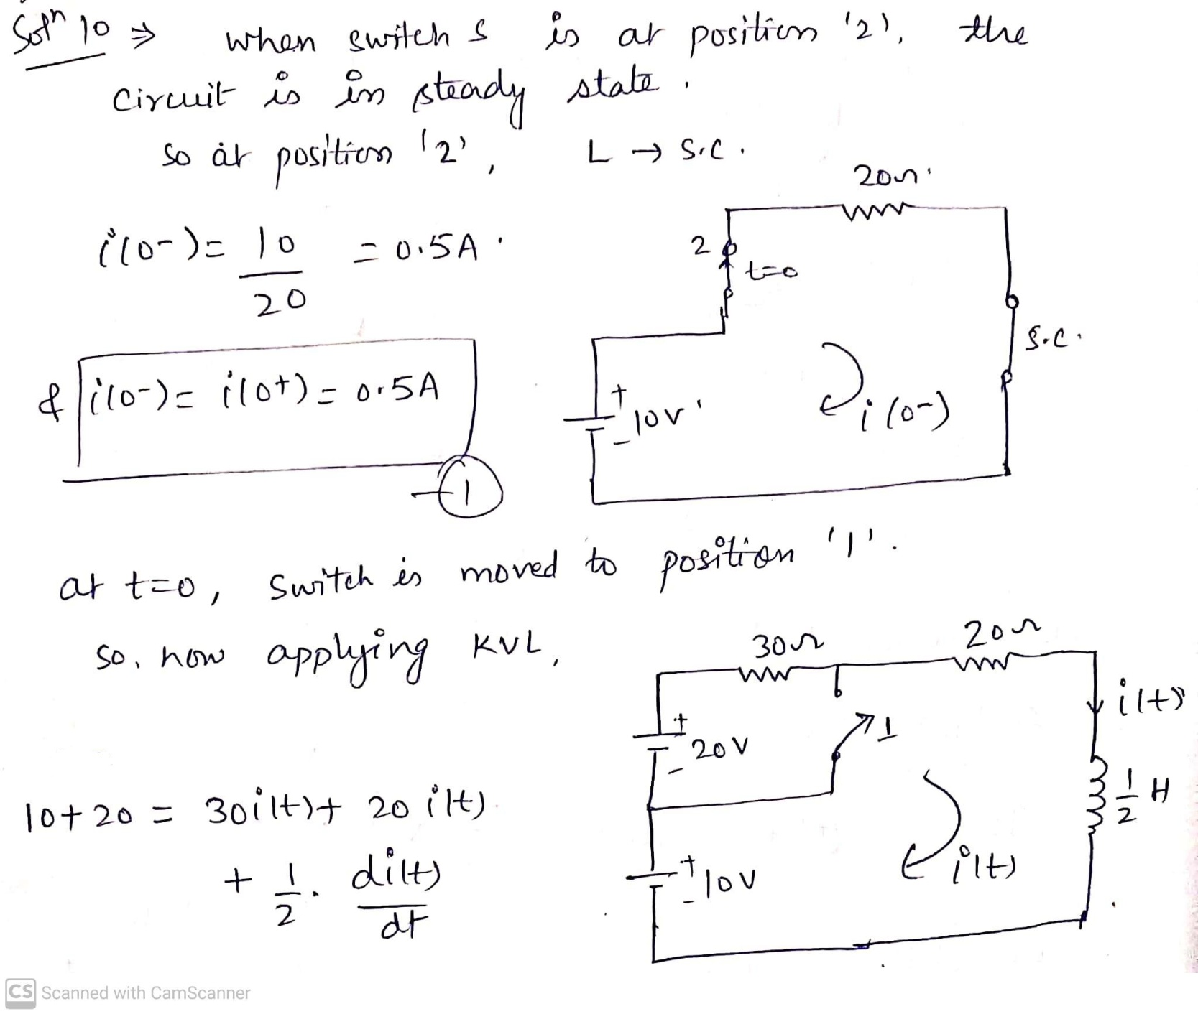

Slide 45
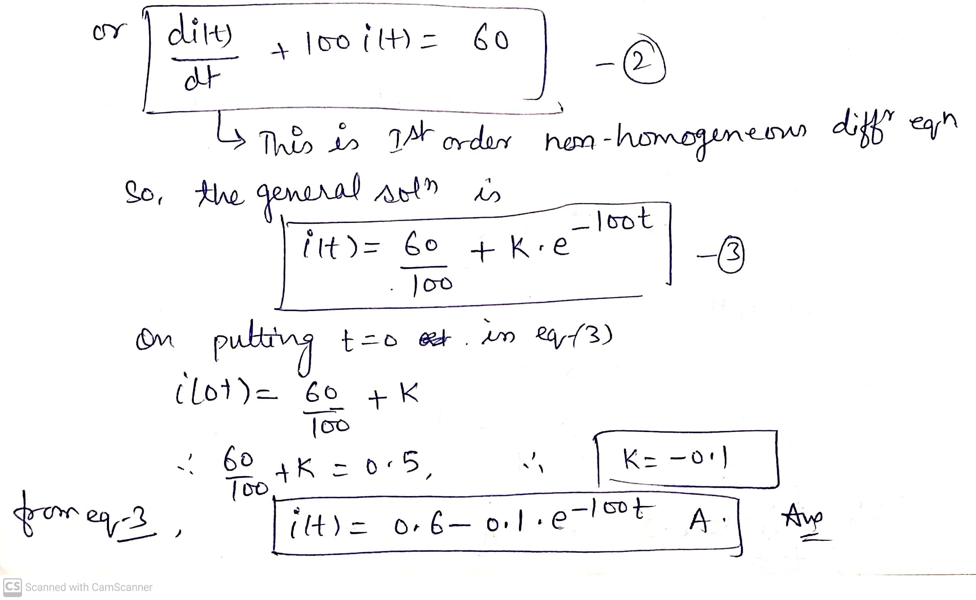

Slide 46
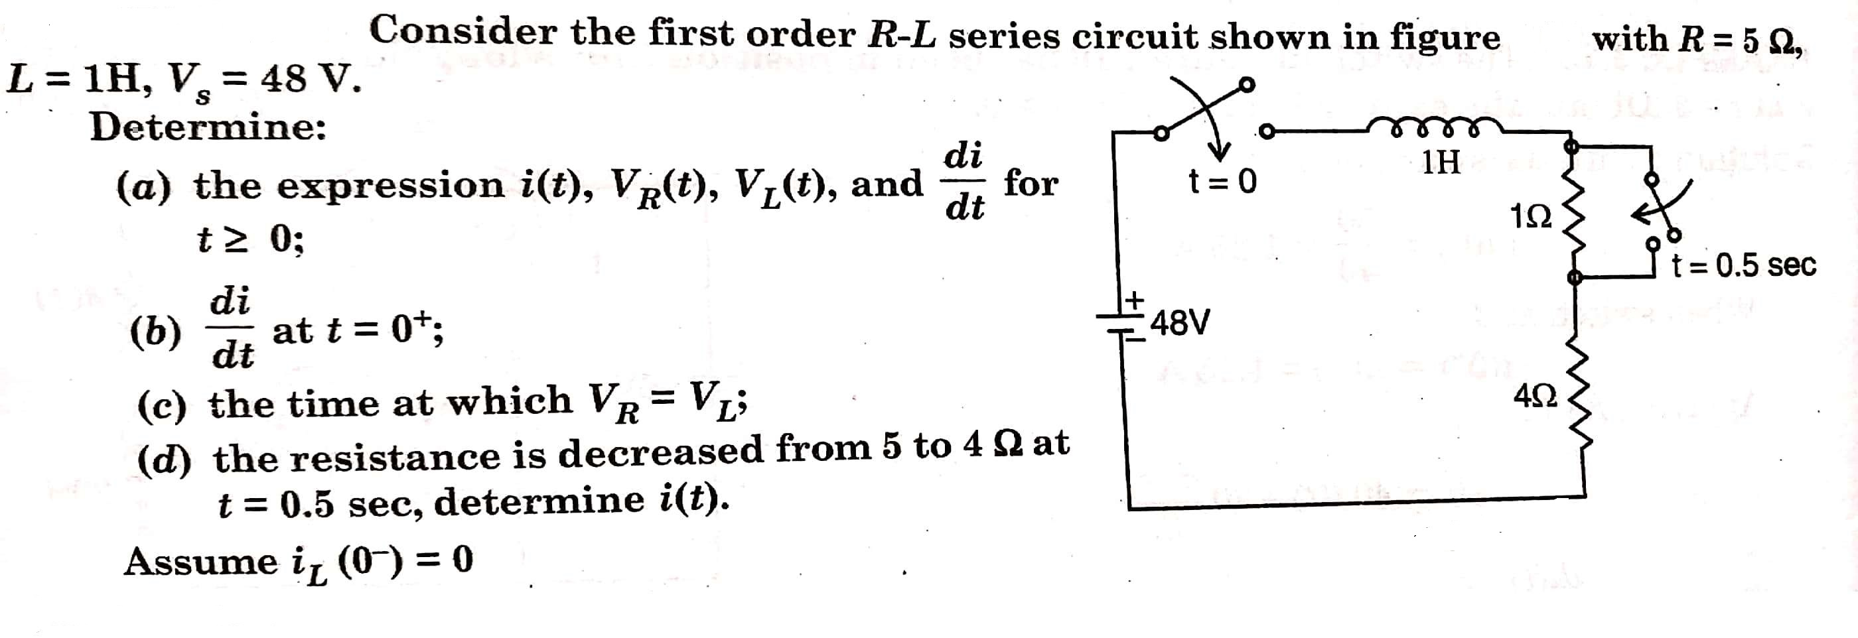
EXAMPLE 11

Slide 47
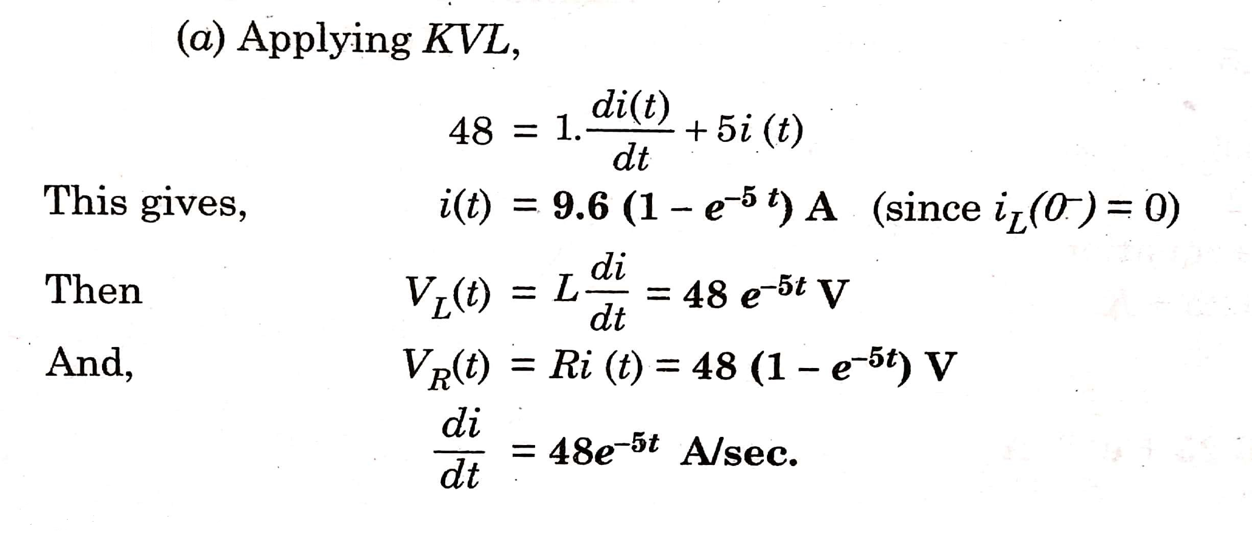
SOLUTION 11

Slide 48
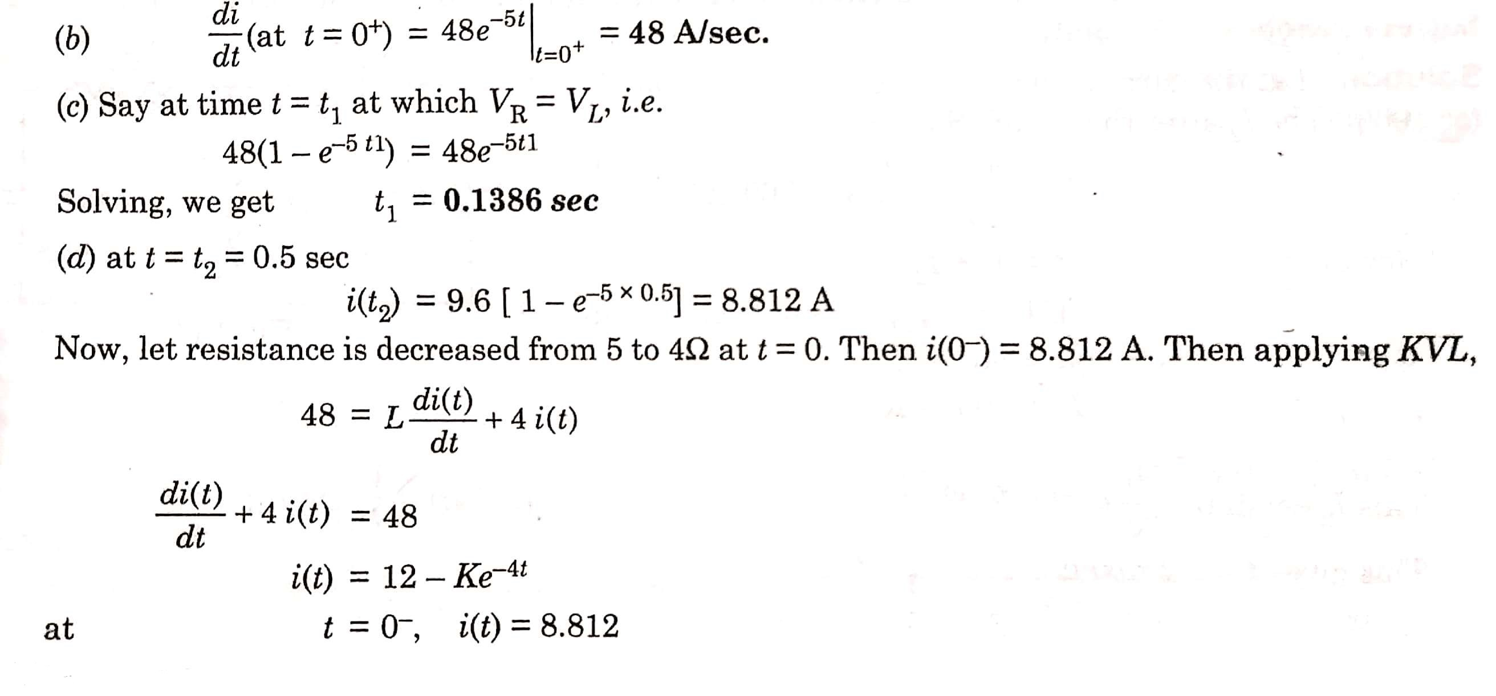
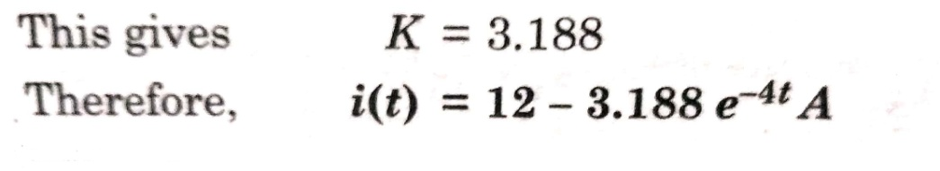

Slide 49
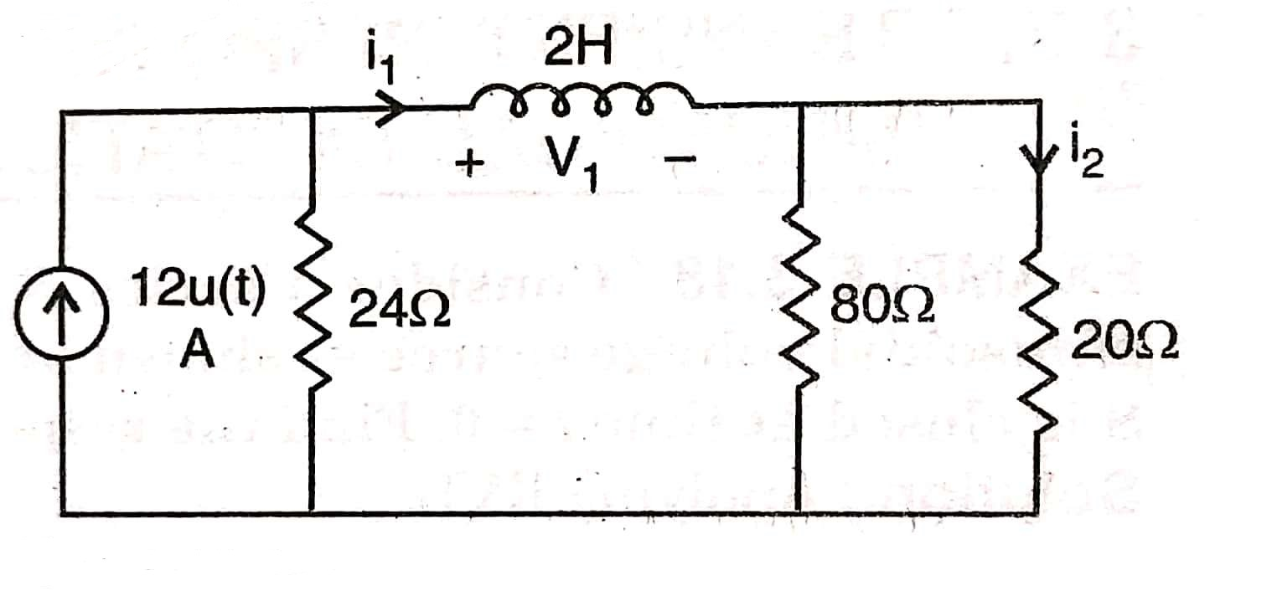
Ex 12) For the network shown in fig below, find i₁, i₂, and V₁ at
(a) t = 0⁻ (b) t = 0⁺
(c) t = ∞ (d) t = 50 msec.

Slide 50
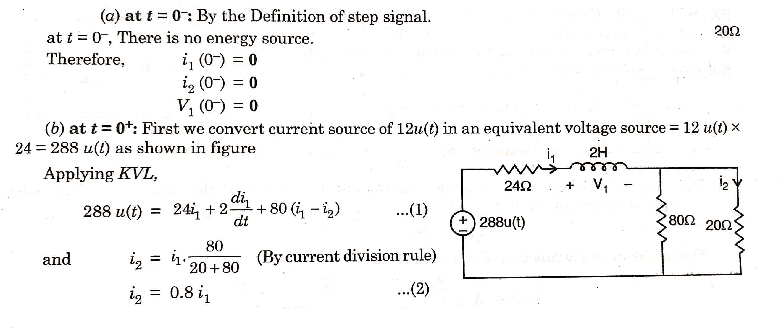
SOLUTION 12

Slide 51
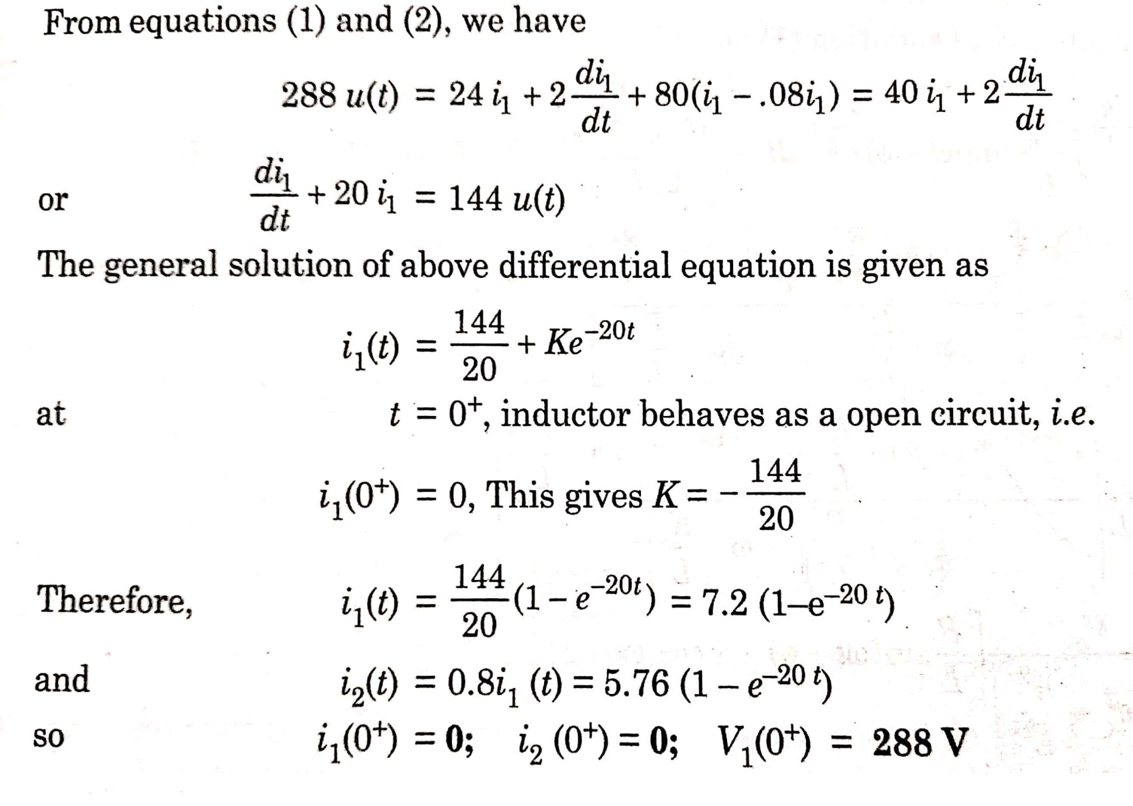

Slide 52
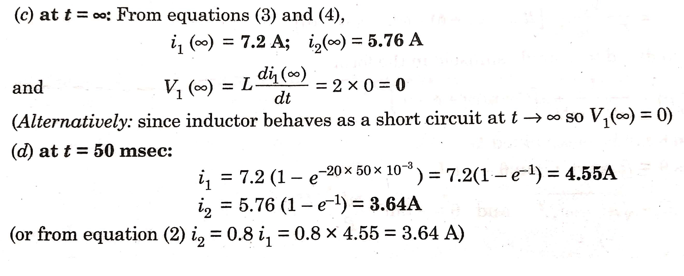
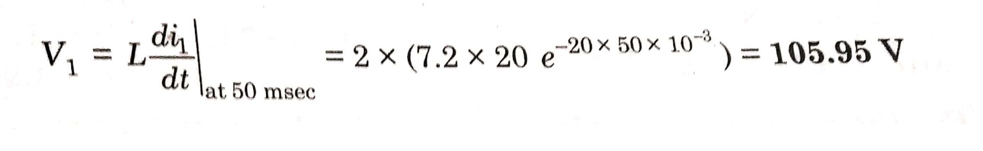

Slide 53
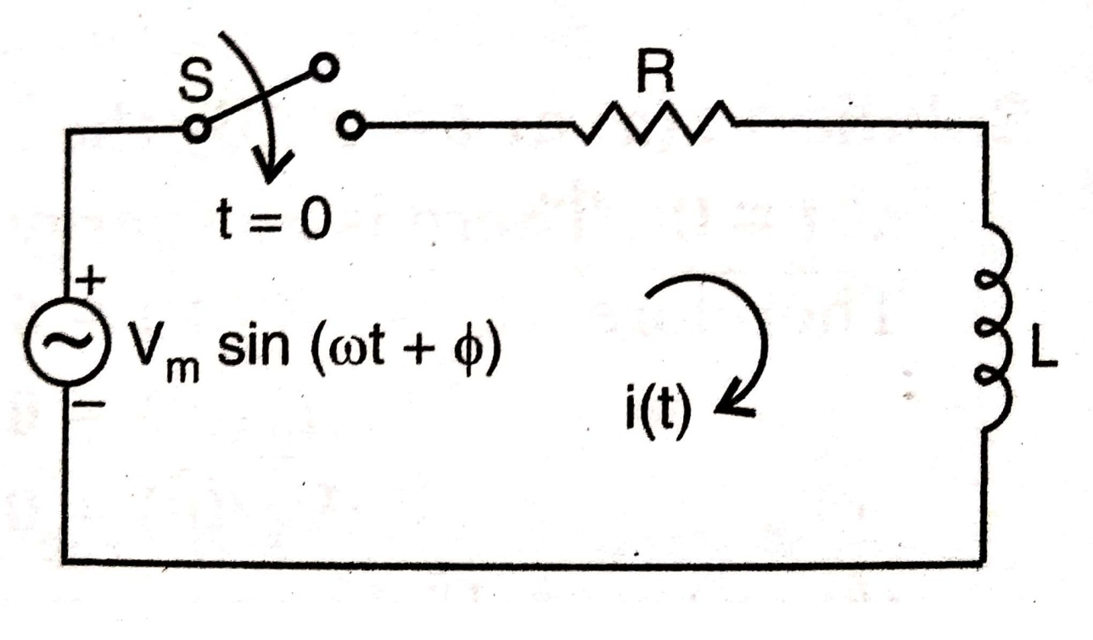
TRANSIENT RESPONSE OF SERIES R-L CIRCUIT HAVING SINUSOIDAL EXCITATION
Q. Consider a series R-L circuit excited by a sinusoidal voltage source as shown in fig below. The switch ‘S’ is closed at time t = 0. Find the response (current) i(t).

Slide 54
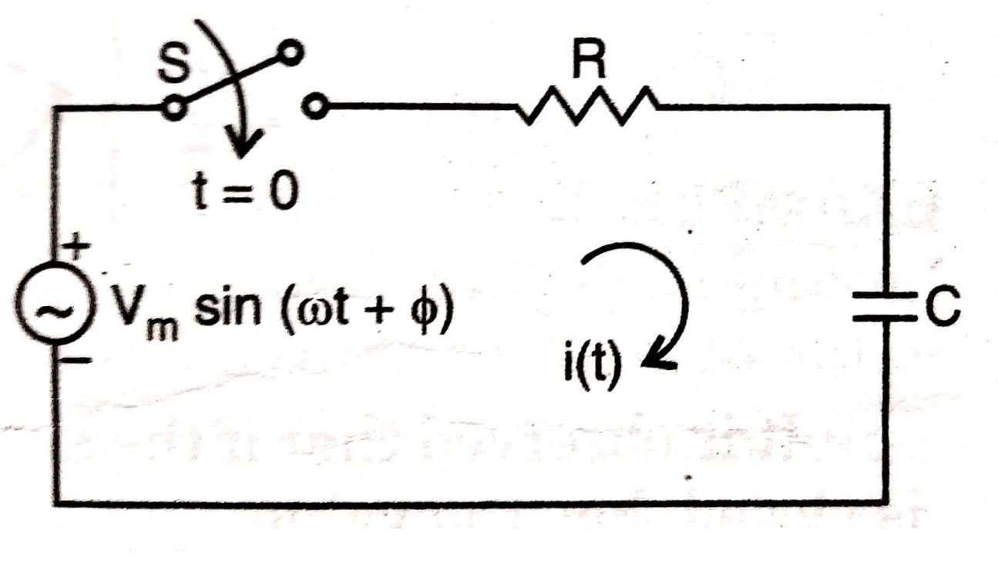
TRANSIENT RESPONSE OF SERIES R-C CIRCUIT HAVING SINUSOIDAL EXCITATION
Q. Consider a series R-C circuit excited by a sinusoidal voltage source as shown in fig below. The switch ‘S’ is closed at time t = 0. Find the response (current) i(t).

Slide 55
QUESTIONS
FOR
PRACTICE

Slide 56
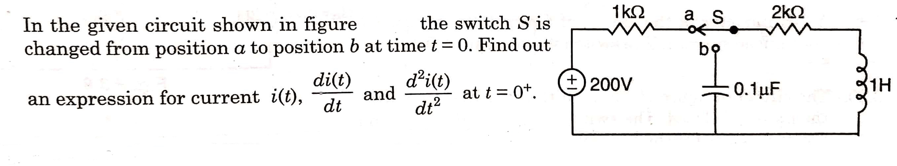
Q 1

Slide 57
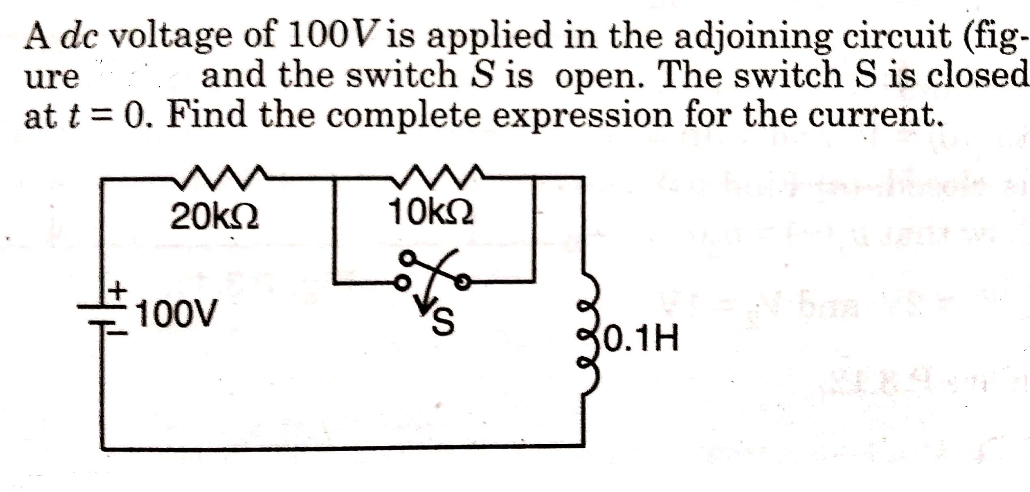
Q 2

Slide 58

Q 3

Slide 59
ANSWERS
1)(66.6 mA, -133.2 A/sec, -400* 10³ A/sec²)
2) 5[ 1- 0.33 e^{-200t})mA; where t in msec.
3) i(0⁺) = 10⁻⁴ A
di/dt(0⁺) = -100 A/sec
d²i/dt²(0⁺) = - 10⁸ A/sec²

